Slide 1

Random Matrix Theory
Numerical Computation and Remarkable Applications
Alan Edelman
Mathematics
Computer Science & AI Labs
AMS Short Course
January 8, 2013
San Diego, CA
Computer Science & AI Laboratories

Slide 2
A Personal Theme
A Computational Trick can also be a Theoretical Trick
  A View: Math stands on its own.
  My View: Rigors of coding, modern numerical linear algebra, and the quest for efficiency has revealed deep mathematics.
    Tridiagonal/Bidiagonal Models
    Stochastic Operators
    Sturm Sequences/Ricatti Diffusion
    Method of Ghosts and Shadows

Slide 3
Outline
Random Matrix Headlines
Crash Course in Theory
Crash Course on being a Random Matrix Theory user
How I Got Into This Business: Random Condition Numbers
Good Computations Leads to Good Mathematics
(If Time) Ghosts and Shadows

Slide 4
Outline
Random Matrix Headlines
Crash Course in Theory
Crash Course on being a Random Matrix Theory user
How I Got Into This Business: Random Condition Numbers
Good Computations Leads to Good Mathematics
(If Time) Ghosts and Shadows

Slide 5
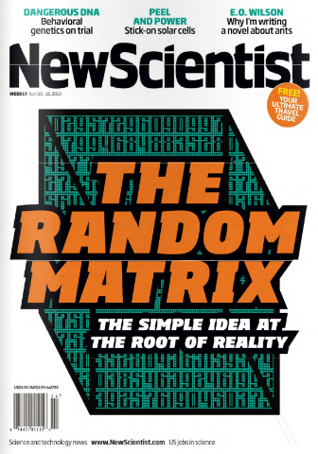


Slide 6
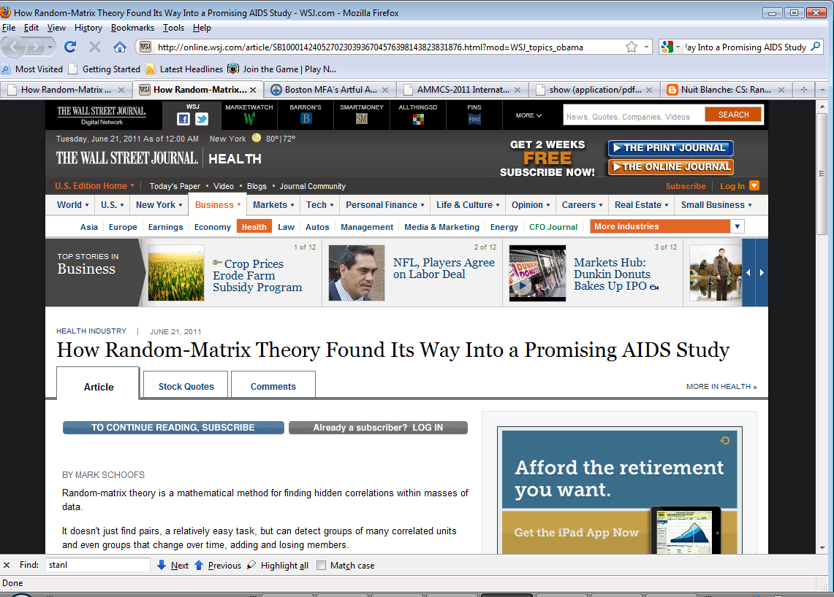
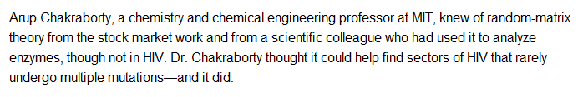

Slide 7
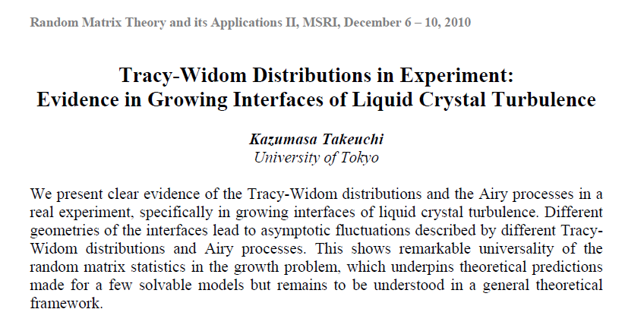

Slide 8
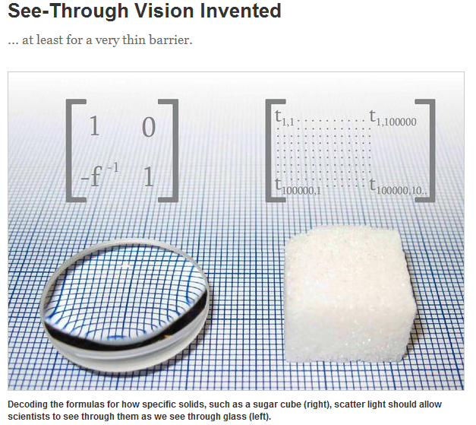
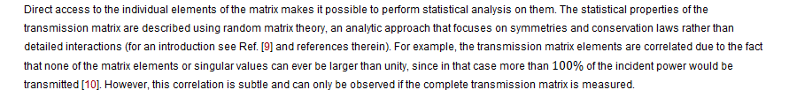

Slide 9
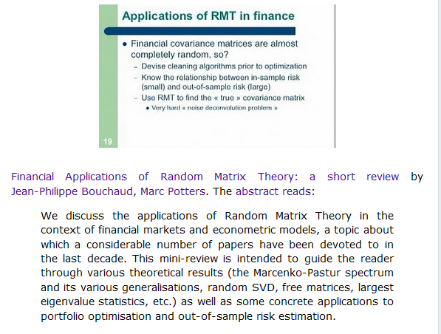

Slide 10
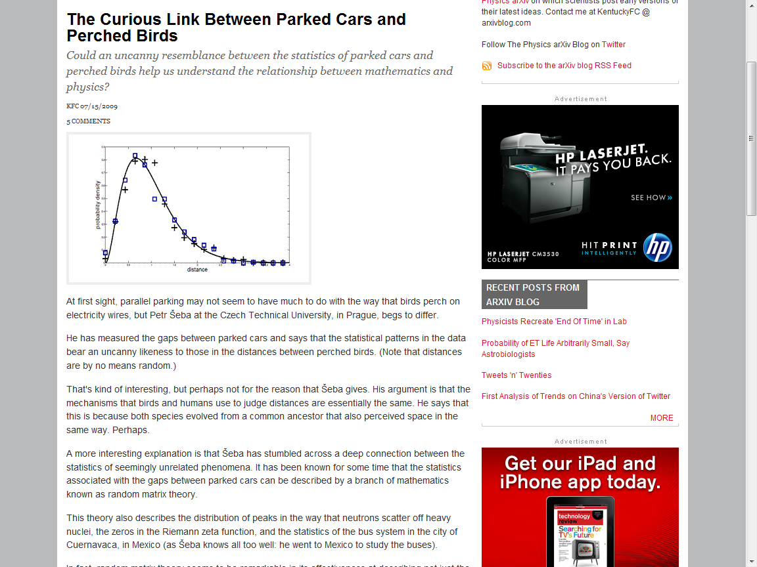

Slide 11
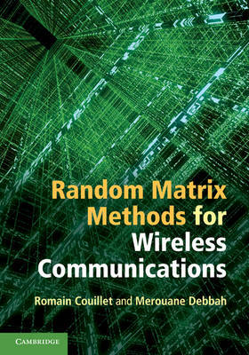
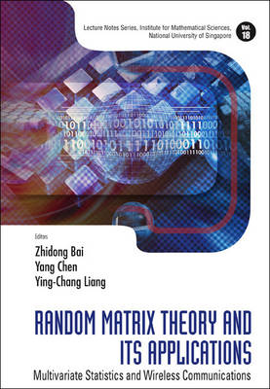

Slide 12
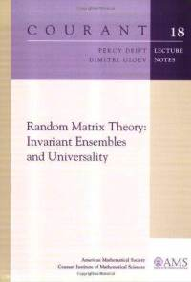
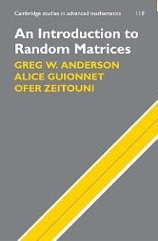
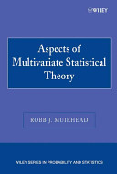
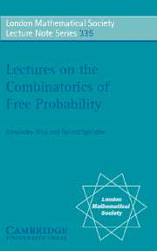
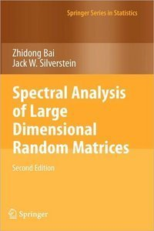
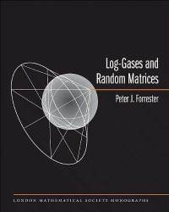
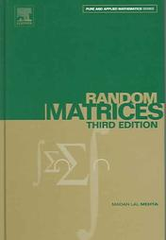
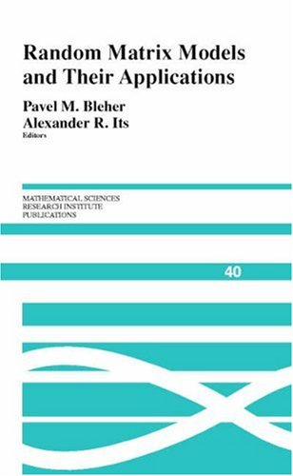

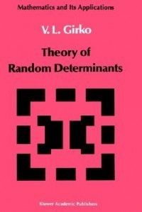
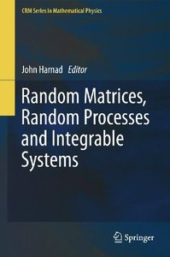
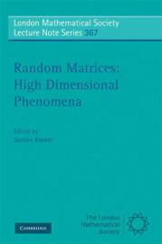

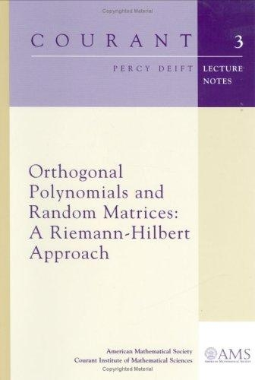
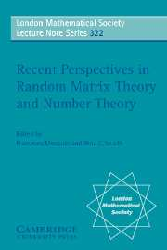

Slide 13
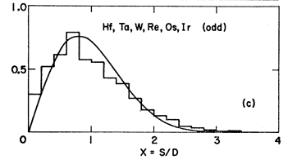
Early View of RMT
Heavy atoms too hard. Let’s throw
up our hands and pretend energy levels come from a random matrix
Our view
Randomness is a structure! A NICE STRUCTURE!!!!
Think sampling elections, central limit theorems,
self-organizing systems, randomized algorithms,…

Slide 14
Random matrix theory in the natural progression of mathematics
Scalar statistics
Vector statistics
Matrix statistics
Established Statistics
Newer Mathematics

Slide 15
Outline
Random Matrix Headlines
Crash Course in Theory
Crash Course on being a Random Matrix Theory user
How I Got Into This Business: Random Condition Numbers
Good Computations Leads to Good Mathematics
(If Time) Ghosts and Shadows

Slide 16
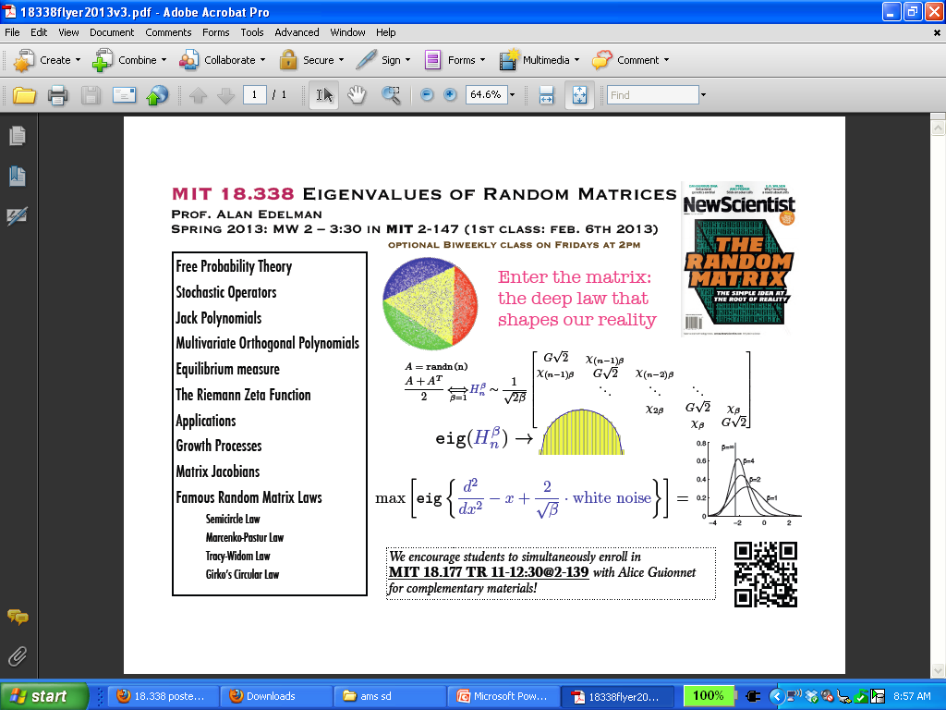
Crash course to introduce the Theory

Slide 17
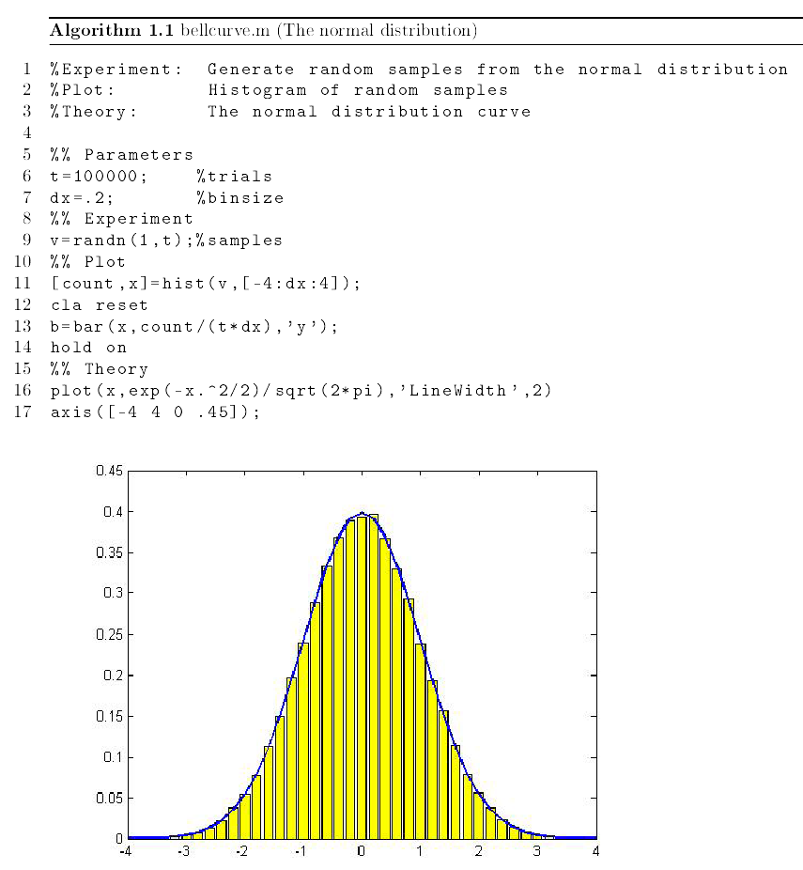
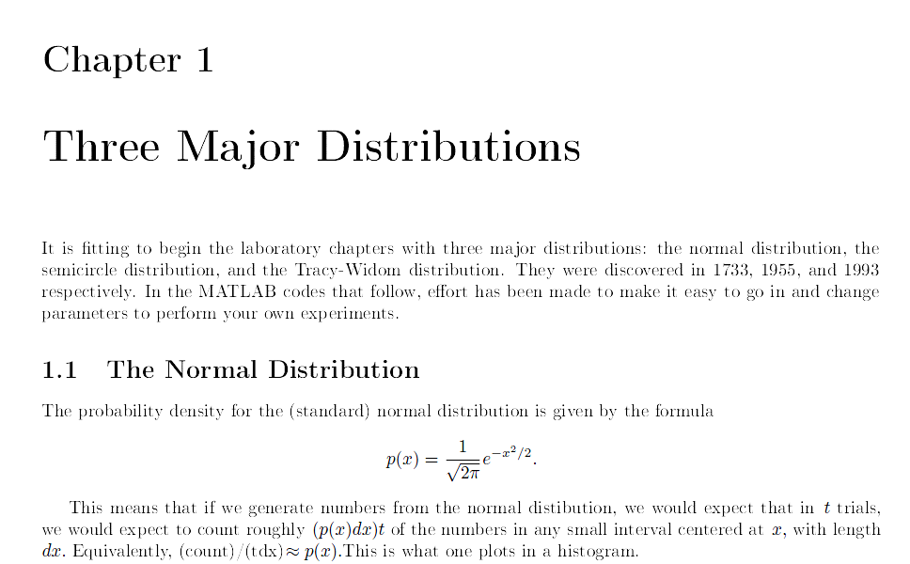
Class Notes from 18.338
Normal Distribution
1733

Slide 18
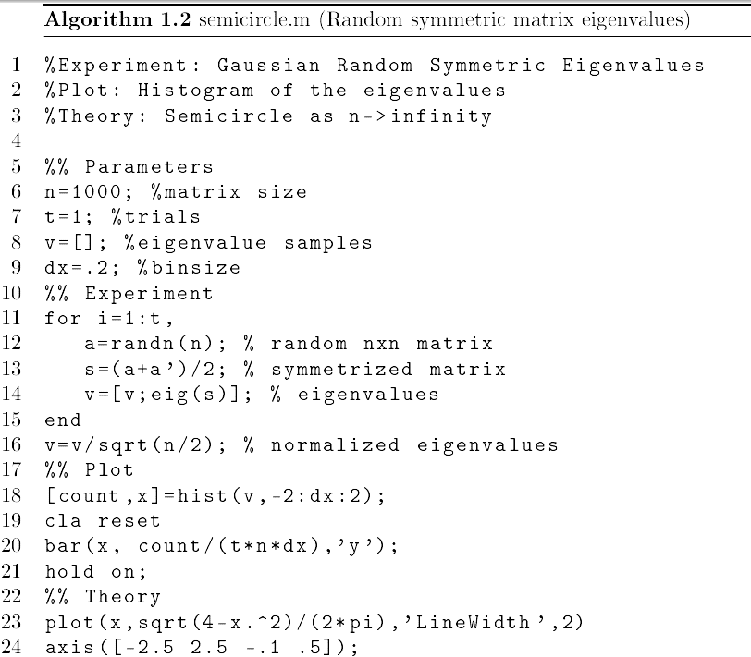
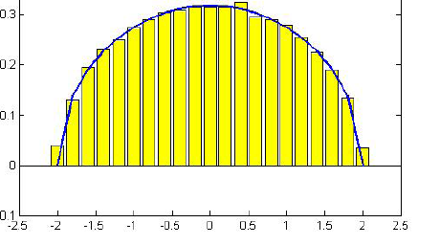
Semicircle Distribution
1955
Semicircle 1955

Slide 19
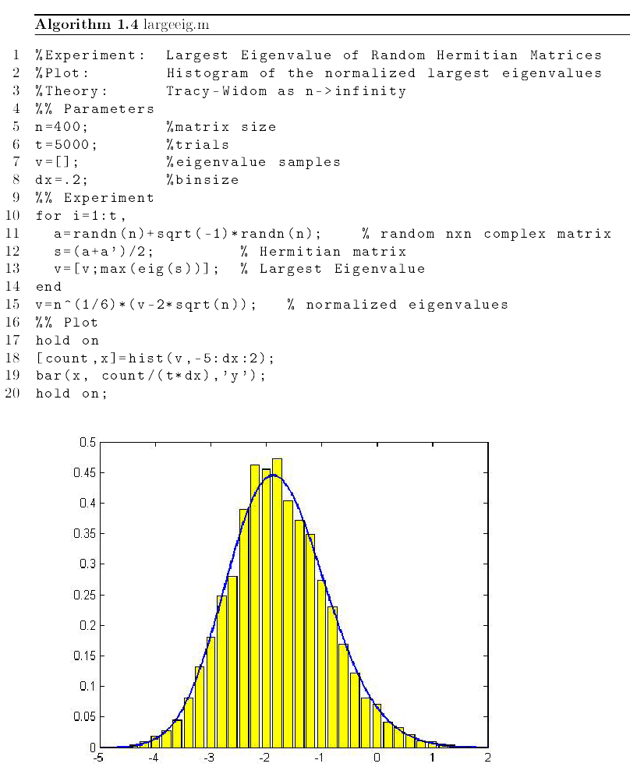
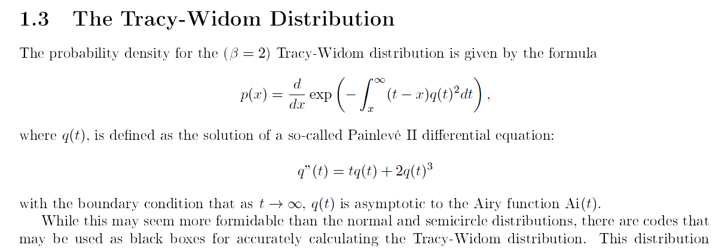
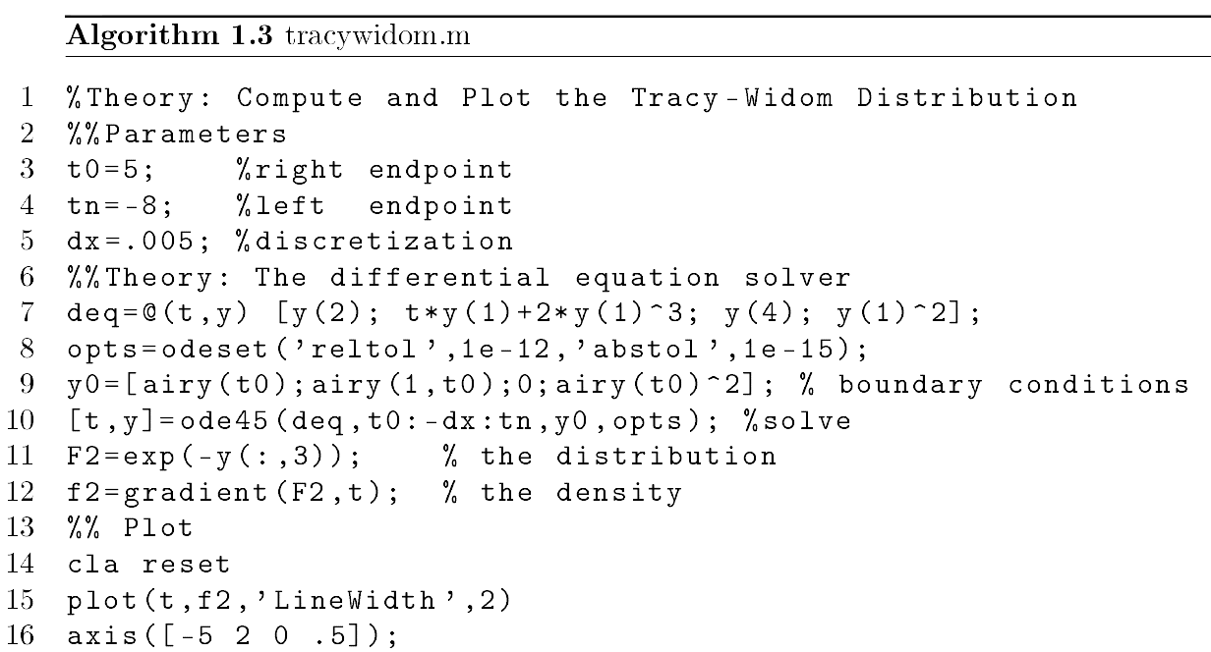
Tracy-Widom Distribution 1993

Slide 20
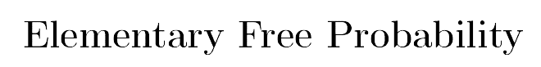
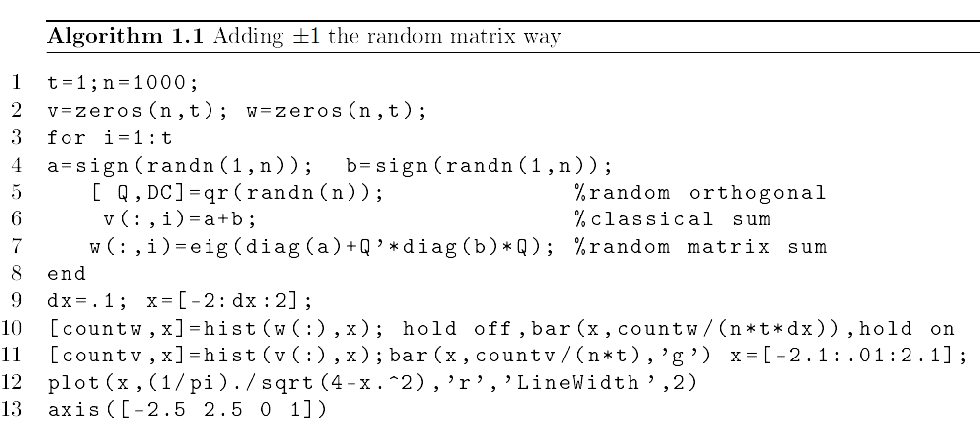
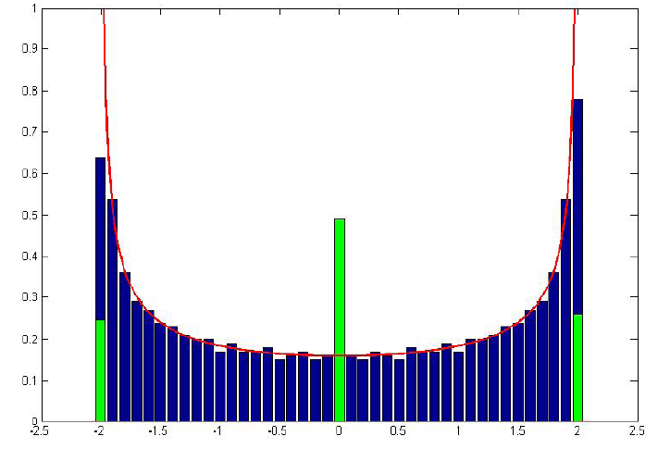
n random ±1’s
eig(A+Q’BQ)

Slide 21
Free Probability
Gives the distribution of the eigenvalues of A+Q’BQ given that of A and B
(as n→∞ theoretically, works well for finite n in practice)
Can be explained with simple calculus to engineers usually in under 30 minutes

Slide 22
Crash Course on White Noise and Brownian Motion
x=[0:h:1]; % h=.001
dW=randn(length(x),1)*sqrt(h); % white noise
W=cumsum(dW); %Brownian motion
plot(x,W)
W = anything + cumsum(dW)
Interpolates anything to gaussians
Free Brownian Motion is
the limit of W where each element
of dW is a GOE *sqrt(h)

Slide 23
Outline
Random Matrix Headlines
Crash Course in Theory
Crash Course on being a Random Matrix Theory user
How I Got Into This Business: Random Condition Numbers
Good Computations Leads to Good Mathematics
(If Time) Ghosts and Shadows

Slide 24
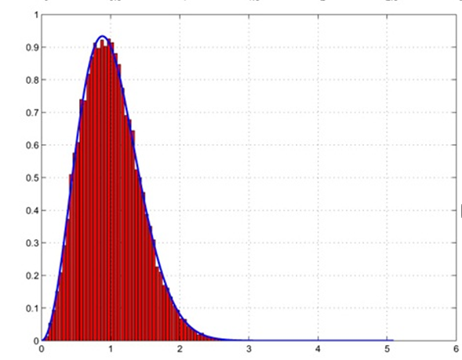

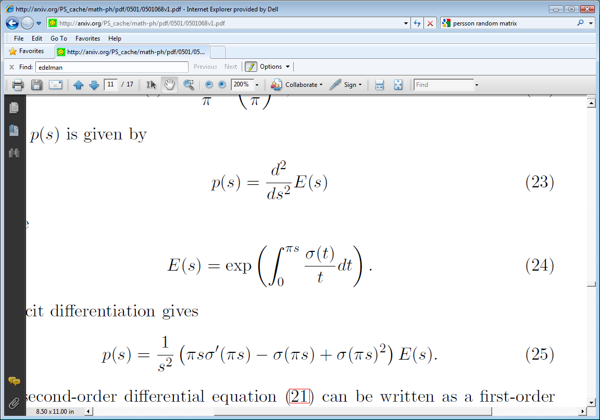
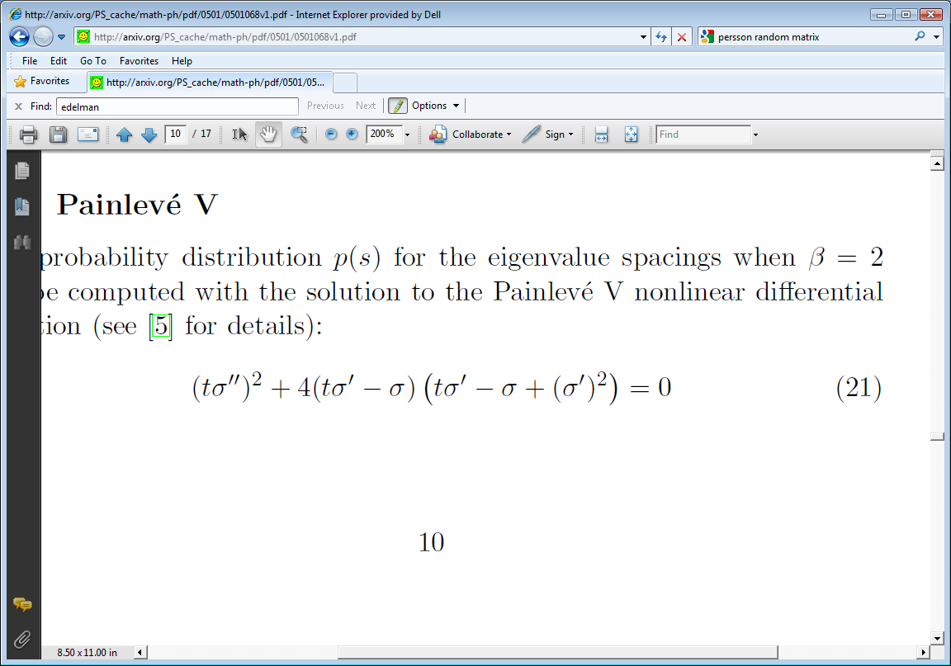
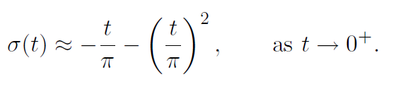
The GUE (Gaussian Unitary Ensemble)
http://matematiku.wordpress.com/2011/05/04/nontrivial-zeros-and-the-eigenvalues-of-random-matrices/
A=randn(n)+i*randn(n); S=(A+A’)/sqrt(4n)
Eigenvalues follow semicircle law
Eigenvalue repel! Spacings follow a known law:
SPACINGS!

Slide 25
Applications
Parked Cars in London
Zeros of the Riemann Zeta Function
Busses in Cuernevaca, Mexico
…..

Slide 26
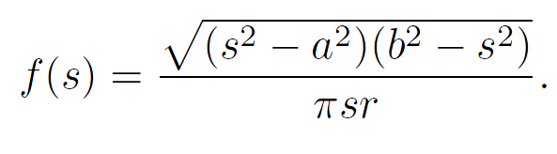
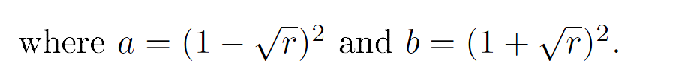
The Marcenko-Pastur Law
The density of the singular values of a normalized rectangular random matrix with aspect ratio r and iid elements (in the infinite limit, etc.)

Slide 27
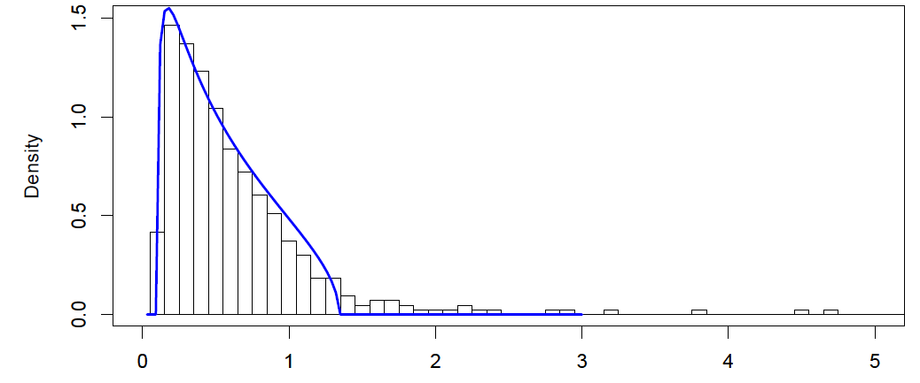
Covariance Matrix Estimation:
Source: http://www.math.nyu.edu/fellows_fin_math/gatheral/RandomMatrixCovariance2008.pdf

Slide 28
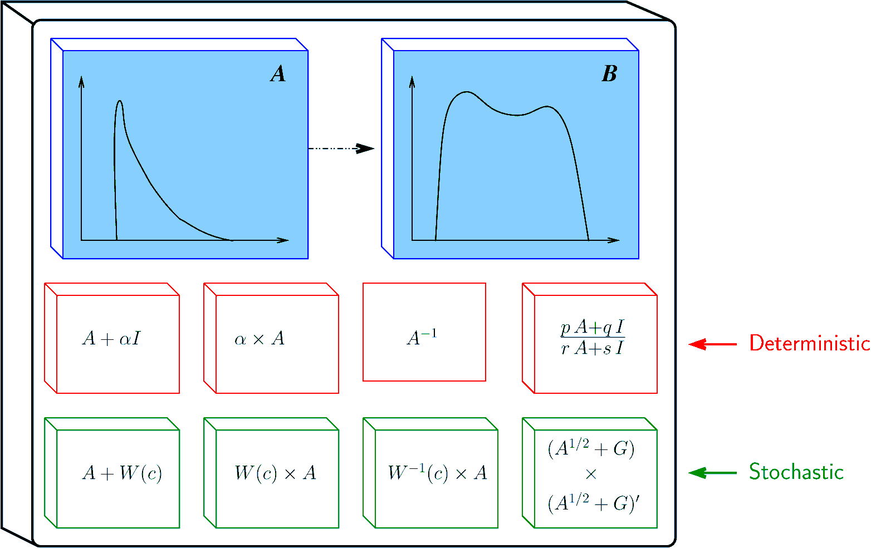
RM Tool – Raj (U Michigan)
Free probability tool
Mathematics: The Polynomial Method

Slide 29
Outline
Random Matrix Headlines
Crash Course in Theory
Crash Course on being a Random Matrix Theory user
How I Got Into This Business: Random Condition Numbers
Good Computations Leads to Good Mathematics
(If Time) Ghosts and Shadows

Slide 30
Numerical Analysis:
Condition Numbers
κ(A) = “condition number of A”
If A=UΣV’ is the svd, then κ(A) = σ_{max}/σ_{min} .
One number that measures digits lost in finite precision and general matrix “badness”
  Small=good
  Large=bad
The condition of a random matrix???

Slide 31
Von Neumann & co.
Solve Ax=b via x= (A’A) ⁻¹A’ b
M ≈A⁻¹
Matrix Residual: ||AM-I||₂
||AM-I||₂< 200κ² n ε
How should we estimate κ?
Assume, as a model, that the elements of A are independent standard normals!
≈

Slide 32
Von Neumann & co. estimates
(1947-1951)
“For a ‘random matrix’ of order n the expectation value has been shown to be about n”
      Goldstine, von Neumann
“… we choose two different values of κ, namely n and √10n”
        Bargmann, Montgomery, vN
“With a probability ~1 … κ < 10n”
      Goldstine, von Neumann
X ∞
P(κ<n) ≈0.02
P(κ< √10n)≈0.44
P(κ<10n) ≈0.80

Slide 33
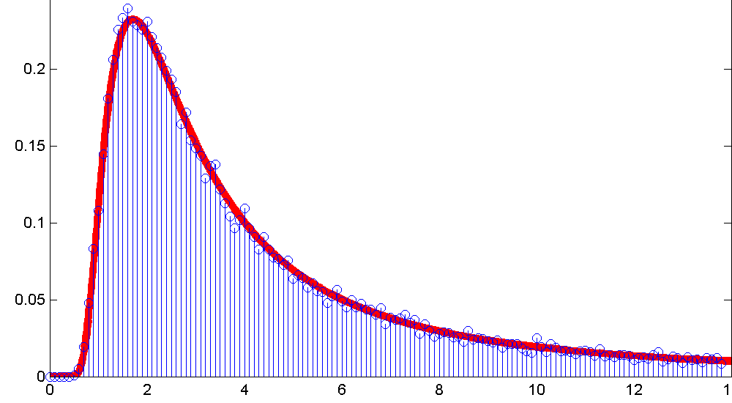
Random cond numbers, n→∞
Distribution of κ/n
Experiment with n=200

Slide 34




Finite n
n=10 n=25
n=50 n=100
Convergence proved by Tao and Vu
Open question: why so fast

Slide 35
Tao-Vu ('09) “the rigorous proof”!
Basic idea (NLA reformulation)...
Consider a 2x2 block QR decomposition of M:
1. The smallest singular value of R₂₂, scaled by √n/s, is a good
estimate for σ_{n}!
2. R₂₂ (viewed as the product Q₂^{T} M₂) is roughly s x s Gaussian
n-s s
n-s s
M = (M₁ M₂) = QR = (Q₁ Q₂)( )
Note: Q₂^{T} M₂ = R₂₂
R₁₁ R₁₂ n-s
R₂₂ s

Slide 36
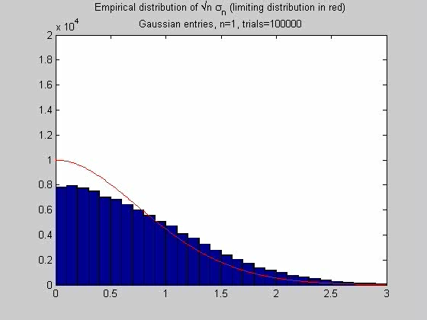
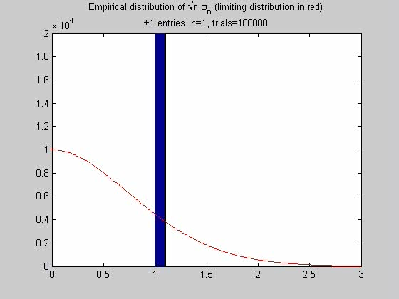
Sanity Checks on the smallest singular value
Gaussians +/- 1 (note many singulars)

Slide 37
Bounds from the proof
“C is a sufficiently large const (10⁴ suffices)”
Implied constants in O(...) depend on E|ξ|^{C}
  For ξ = Gaussian, this is 9999!!
s = n^{500/C}
  To get s = 10, n ≈ 10²⁰?
Various tail bounds go as n^{-1/C}
  To get 1% chance of failure, n ≈ 10²⁰⁰⁰⁰??

Slide 38
Good Computation → Good Mathematics

Slide 39
Outline
Random Matrix Headlines
Crash Course in Theory
Crash Course on being a Random Matrix Theory user
How I Got Into This Business: Random Condition Numbers
Good Computations Leads to Good Mathematics
(If Time) Ghosts and Shadows

Slide 40
Outline
Random Matrix Headlines
Crash Course in Theory
Crash Course on being a Random Matrix Theory user
How I Got Into This Business: Random Condition Numbers
Good Computations Leads to Good Mathematics
(If Time) Ghosts and Shadows

Slide 41
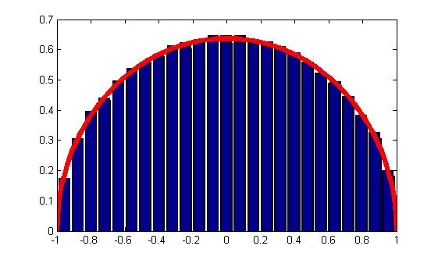
Eigenvalues of GOE (β=1)
Naïve Way:
  MATLAB®: A=randn(n); S=(A+A’)/sqrt(2*n);eig(S)
  R:
  A=matrix(rnorm(n*n),ncol=n);S=(a+t(a))/sqrt(2*n);eigen(S,symmetric=T,only.values=T)$values;
  Mathematica: A=RandomArray[NormalDistribution[],{n,n}];S=(A+Transpose[A])/Sqrt[n];Eigenvalues[s]

Slide 42
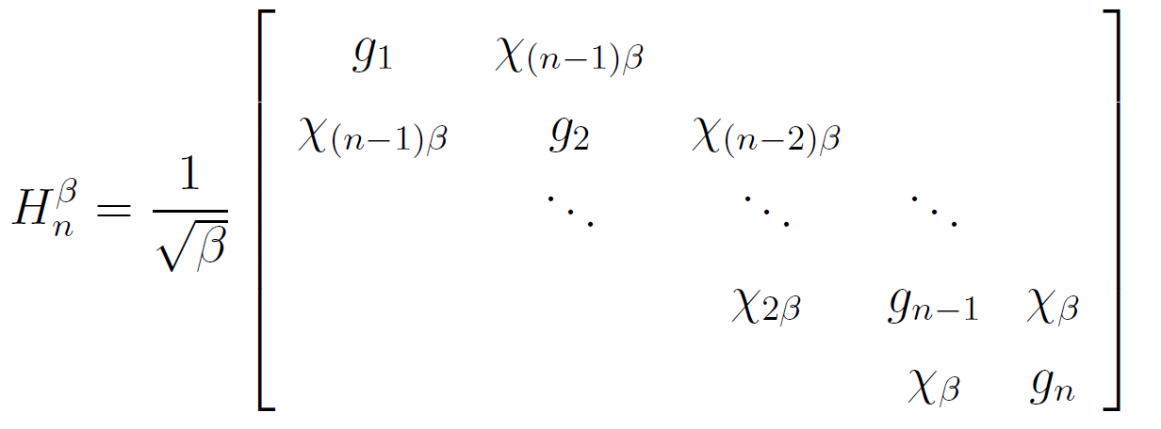
Tridiagonal Model More Efficient
LAPACK’s DSTEQR
Storage: O(n) (vs O(n²))
Time: O(n²) (vs O(n³))
Real Matrices
Beta Hermite ensemble
g_{i} ~N(0,2)
(Silverstein, Trotter, etc)

Slide 43
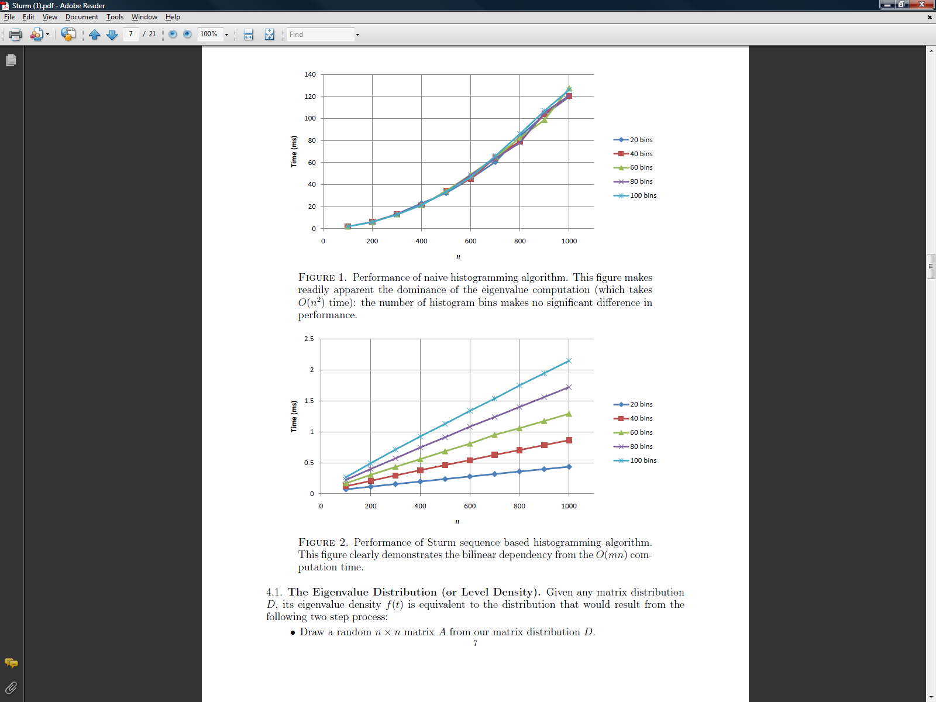
Histogram without Histogramming:
Sturm Sequences
Count #eigs < 0.5: Count sign changes in
  Det( (A-0.5*I)[1:k,1:k] )
Count #eigs in [x,x+h]
    Take difference in number of sign changes at x+h and x
Mentioned in Dumitriu and E 2006,
Used theoretically in Albrecht, Chan, and E 2008

Slide 44
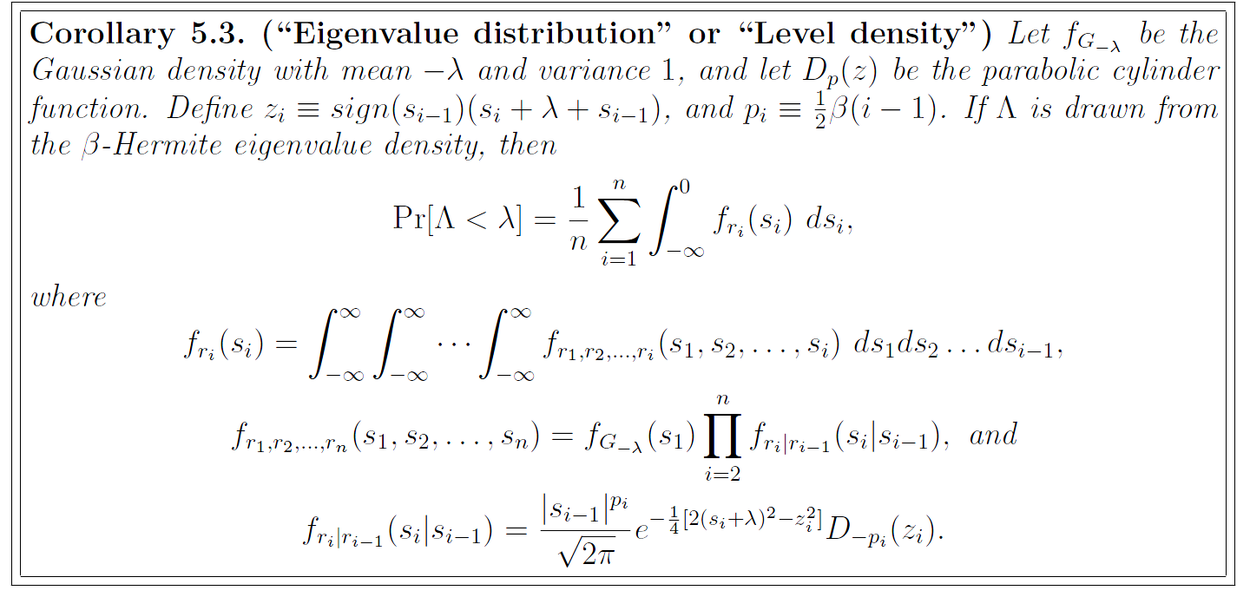

A good computational trick is a good theoretical trick!
Finite Semi-Circle Laws for Any Beta!
Finite Tracy-Widom Laws for Any Beta!

Slide 45
Efficient Tracy Widom Simulation
Naïve Way:
A=randn(n); S=(A+A’)/sqrt(2*n);max(eig(S))
Better Way:
Only create the 10n^{1/3} initial segment of the diagonal and off-diagonal as the “Airy” function tells us that the max eig hardly depends on the rest

Slide 46
Stochastic Operator – the best way
converges to
d
2
2
−
x
+
dW
,
dx
2
β

Slide 47
Obervation
Distributions you have seen are asymptotic limits!
The matrices were left behind.
Now we have stochastic operators whose distributions themselves can be studied.

Slide 48
Tracy Widom Best Way
d
2
2
−
x
+
dW
,
dx
2
β
MATLAB:
Diagonal =(-2/h^2)*ones(1,N) – x +(2/sqrt(beta))*randn(1,N)/sqrt(h)
Off Diagonal = (1/h^2)*ones(1,N-1)
See applications by Alex Bloemendal, Balint Virag etc.

Slide 49
Outline
Random Matrix Headlines
Crash Course in Theory
Crash Course on being a Random Matrix Theory user
How I Got Into This Business: Random Condition Numbers
Good Computations Leads to Good Mathematics
(If Time) Ghosts and Shadows

Slide 50

The method of Ghosts and Shadows for Beta Ensembles

Slide 51
Introduction to Ghosts
G₁ is a standard normal N(0,1)
G₂ is a complex normal (G₁ +iG₁)
G₄ is a quaternion normal (G₁ +iG₁+jG₁+kG₁)
G_{β} (β>0) seems to often work just fine
  →“Ghost Gaussian”

Slide 52
Chi-squared
Defn: χ_{β} is the sum of β iid squares of standard normals if β=1,2,…
Generalizes for non-integer β as the “gamma” function interpolates factorial
χ _{β} is the sqrt of the sum of squares (which generalizes) (wikipedia chi-distriubtion)
|G₁| is χ _{1 ,} |G₂| is χ ₂, |G₄| is χ ₄
So why not |G _{β} | is χ _{β} ?
I call χ _{β} the shadow of G _{β}
²

Slide 53

Wishart Matrices
(arbitrary covariance)
G=mxn matrix of Gaussians
Σ=mxn semidefinite matrix
G’G Σ is similar to A=Σ^{½}G’GΣ^{-½}
For β=1,2,4, the joint eigenvalue density of A has a formula:
Known for β=2 in some circles as Harish-Chandra-Itzykson-Zuber

Slide 54
Main Purpose of this talk
Eigenvalue density of G’G Σ ( similar to A=Σ^{½}G’GΣ^{-½ )}
Present an algorithm for sampling from this density
Show how the method of Ghosts and Shadows can be used to derive this algorithm
Further evidence that β=1,2,4 need not be special

Slide 55


Slide 56
Scary Ideas in Mathematics
Zero
Negative
Radical
Irrational
Imaginary
Ghosts: Something like a sometimes commutative algebra of random variables that generalizes random Reals, Complexes, and Quaternions and inspires theoretical results and numerical computation

Slide 57
Did you say “commutative”??
Quaternions don’t commute.
Yes but random quaternions do!
If x and y are G₄ then x*y and y*x are identically distributed!

Slide 58
RMT Densities
Hermite:
  c ∏|λ_{i}-λ_{j}|^{β} e^{-∑λi2/2} (Gaussian Ensemble)
Laguerre:
  c ∏|λ_{i}-λ_{j}|^{β} ∏λ_{i}^{m} e^{-∑λi} (Wishart Matrices)
Jacobi:
  c ∏|λ_{i}-λ_{j}|^{β} ∏λ_{i}^{m1} ∏(1-λ_{i})^{m2} (Manova Matrices)
Fourier:
  c ∏|λ_{i}-λ_{j}|^{β} (on the complex unit circle) (Circular Ensembles)
  (orthogonalized by Jack Polynomials)

Slide 59
Wishart Matrices
(arbitrary covariance)
G=mxn matrix of Gaussians
Σ=mxn semidefinite matrix
G’G Σ is similar to A=Σ^{½}G’GΣ^{-½}
For β=1,2,4, the joint eigenvalue density of A has a formula:

Slide 60
Joint Eigenvalue density of G’G Σ
The “₀F₀” function is a hypergeometric function of two matrix arguments that depends only on the eigenvalues of the matrices. Formulas and software exist.

Slide 61


Generalization of Laguerre
Laguerre:
Versus Wishart:

Slide 62
General β?
The joint density:
is a probability density for all β>0.
Goals:
Algorithm for sampling from this density
Get a feel for the density’s “ghost” meaning

Slide 63
Main Result
An algorithm derived from ghosts that samples eigenvalues
A MATLAB implementation that is consistent with other beta-ized formulas
  Largest Eigenvalue
  Smallest Eigenvalue

Slide 64

Working with Ghosts
Real quantity

Slide 65

More practice with Ghosts

Slide 66

Bidiagonalizing Σ=I
Z’Z has the Σ=I density giving a special case of

Slide 67

The Algorithm for Z=GΣ^{½}

Slide 68

The Algorithm for Z=GΣ^{½}

Slide 69

Removing U and V

Slide 70

Algorithm cont.

Slide 71

Completion of Recursion

Slide 72

Numerical Experiments – Largest Eigenvalue
Analytic Formula for largest eigenvalue dist
E and Koev: software to compute

Slide 73


Slide 74


Slide 75


Slide 76

Smallest Eigenvalue as Well
The cdf of the smallest eigenvalue,

Slide 77

Cdf’s of smallest eigenvalue

Slide 78
Goals
Continuum of Haar Measures generalizing orthogonal, unitary, symplectic
Place finite random matrix theory “β”into same framework as infinite random matrix theory: specifically β as a knob to turn down the randomness, e.g. Airy Kernel
  –d²/dx²+x+(2/β^{½})dW ←White Noise

Slide 79
Formally
Let S_{n}=2π/Γ(n/2)=“surface area of sphere”
    Defined at any n= β>0.
A β-ghost x is formally defined by a function f_{x}(r) such that ∫∞ f_{x}(r) r^{β-1}S_{β-1}dr=1.
Note: For β integer, the x can be realized as a random spherically symmetric variable in β dimensions
Example: A β-normal ghost is defined by
  f(r)=(2π)^{-β/2}e^{-r2/2}
Example: Zero is defined with constant*δ(r).
Can we do algebra? Can we do linear algebra?
Can we add? Can we multiply?
_{r=0}

Slide 80
Understanding ∏|λ_{i}-λ_{j}|^{β}
Define volume element (dx)^ by
  (r dx)^=r^{β}(dx)^ (β-dim volume, like fractals, but don’t really see any fractal theory here)
Jacobians: A=QΛQ’ (Sym Eigendecomposition)
  Q’dAQ=dΛ+(Q’dQ)Λ- Λ(Q’dQ)
  (dA)^=(Q’dAQ)^= diagonal ^ strictly-upper
  diagonal = ∏dλ_{i} =(dΛ)^
  off-diag = ∏((Q’dQ)_{ij}(λ_{i}-λ_{j}))^=(Q’dQ)^ ∏|λ_{i}-λ_{j}|^{β}

Slide 81
Conclusion
Random Matrices are Really Useful!
The totality of the subject is huge
  Try to get to know it from all corners!
Most Problems still unsolved!
A good computational trick is a good theoretical trick!

Slide 83

Haar Measure
β=1: E_{Q}(trace(AQBQ’)^{k})=∑C_{κ}(A)C_{κ}(B)/C_{κ}(I)
Forward Method: Suppose you know C_{κ}’s a-priori. (Jack Polynomials!)
Let A and B be diagonal indeterminants (Think Generating Functions)
Then can formally obtain moments of Q:
Example: E(|q₁₁|²|q₂₂|²) = (n+α-1)/(n(n-1)(n+α))
α:=2/ β
Can Gram-Schmidt the ghosts. Same answers coming up!

Slide 84
A few more operations
ΙΙxΙΙ is a real random variable whose density is given by f_{x}(r)
(x+x’)/2 is real random variable given by multiplying ΙΙxΙΙ by a beta distributed random variable representing a coordinate on the sphere

Slide 85
Addition of Independent Ghosts:
Addition returns a spherically symmetric object
Have an integral formula
Prefer: Add the real part, imaginary part completed to keep spherical symmetry

Slide 86
Multiplication of Independent Ghosts
Just multiply ΙΙzΙΙ’s and plug in spherical symmetry
Multiplication is commutative
  (Important Example: Quaternions don’t commute, but spherically symmetric random variables do!)

Slide 87

Further Uses of Ghosts
Multivariate Orthogonal Polynomials
Tracy-Widom Laws
Largest Eigenvalues/Smallest Eigenvalues
Expect lots of uses to be discovered…

Slide 88
Numerical Tools

Slide 89
Entertainment

Slide 90
Random Triangles,
Random Matrices, and Lewis Carroll
Alan Edelman
Mathematics
Computer Science & AI Labs
Gilbert Strang
Mathematics
Computer Science & AI Laboratories

Slide 91


What do triangles look like?
Popular triangles (Google!) are all acute
Textbook (generic) triangles are always acute

Slide 92


What is the probability that a random triangle is acute?
January 20, 1884

Slide 93

Depends on your definition of random: One easy case!
Uniform on the space
(Angle 1)+(Angle 2)+(Angle 3)=180º
Prob(Acute)=¼

Slide 94
Another case/same answer: normals! P(acute)=¼
3 vertices x 2 coordinates =
6 independent Standard Normals
Experiment:
A=randn(2,3)
=triangle vertices
Not the same probability measure!
Open problem:give a satisfactory explanation of why both measures should give the same answer

Slide 95


An interesting experiment
Compute side lengths normalized to a²+b²+c²=1
Plot (a²,b²,c²) in the plane x+y+z=1
Black=Obtuse Blue=Acute
Dot density largest near the perimeter
Dot density = uniform on hemisphere as it appears to the eye from above

Slide 96

Kendall and others, “Shape Space”
Kendall “Father” of modern probability theory in Britain.

Slide 97

Connection to Linear Algebra
The problem is equivalent to knowing the condition number distribution of a random 2x2 matrix of normals normalized to Frobenius norm 1.

Slide 98

Connection to Shape Theory

Slide 99

In Terms of Singular Values
A=(2x2 Orthogonal)(Diagonal)(Rotation(θ))
Longitude on hemisphere = 2θ
z-coordinate on hemisphere = determinant
Condition Number density (Edelman 89) =
Or the normalized determinant is uniform:
Also ellipticity statistic in multivariate statistics!

Slide 100
What are the Eigenvalues of a Sum of (Non-Commuting)
Random Symmetric Matrices? :
A "Quantum Information" Inspired Answer.
Alan Edelman
Ramis Movassagh

Slide 101

Example Result p=1 → classical probability p=0→ isotropic convolution (finite free probability)
We call this “isotropic
entanglement”

Slide 102

Simple Question
The eigenvalues of
where the diagonals are random, and randomly ordered. Too easy?

Slide 103

Another Question
The eigenvalues of
T
where Q is orthogonal with Haar measure. (Infinite limit = Free probability)

Slide 104
Quantum Information Question
The eigenvalues of
T
I like to think of the two extremes as
localized eigenvectors and delocalized
eigenvectors!
where Q is somewhat complicated.
(This is the general sum of two symmetric matrices)

Slide 105
Moments?

Slide 106

Wishart

Slide 107


Slide 108
Stochastic Differential Operators
Eigenvalues may be as important as stochastic differential equations

Slide 109
Everyone’s Favorite Tridiagonal
-2 | 1
1 | -2 | 1
 |  |  |  | 1
 |  |  | 1 | -2
1
n²
…
…
…
…
…
d²
dx²

Slide 110
Everyone’s Favorite Tridiagonal
-2 | 1
1 | -2 | 1
 |  |  |  | 1
 |  |  | 1 | -2
G
 | G
 |  |  |  | G
1
(βn)^{1/2}
1
n²
…
…
…
+
…
…
d²
dx²
dW
β^{1/2}
+

Slide 111
Conclusion
Random Matrix Theory is rich, exciting, and ripe for applications
Go out there and use a random matrix result in your area

Slide 112


Slide 113

Equilibrium Measures (kind of a maximum likelihood distribution)
Riemann-Hilbert Problems

Slide 114
Multivariate Orthogonal Polynomials
&
Hypergeometrics of Matrix Argument
The important special functions of the 21st century
Begin with w(x) on I
  ∫ p_{κ}(x)p_{λ}(x) Δ(x)^{β} ∏_{i} w(x_{i})dx_{i} = δ_{κλ}
  Jack Polynomials orthogonal for w=1 on the unit circle. Analogs of x^{m}

Slide 115

Multivariate Hypergeometric Functions

Slide 116
Multivariate Hypergeometric Functions

Slide 117

Hypergeometric Functions of Matrix Argument, Zonal Polynomials, Jack Polynomials
Exact computation
of “finite” Tracy Widom
laws

Slide 118

Mops (Dumitriu etc. 2004) Symbolic

Slide 119

Symbolic MOPS applications
A=randn(n); S=(A+A’)/2; trace(S^4)
det(S^3)

Slide 120

Symbolic MOPS applications
β=3; hist(eig(S))

Slide 121

Smallest eigenvalue statistics
A=randn(m,n); hist(min(svd(A).^2))

Slide 123

Painlevé Equations

