Slide 1
The “New” matrix statistics of Random Matrix Theory and the Julia Programming Language
Alan Edelman
Mathematics
Computer Science & AI Labs
IMS/ASA 2012
June 15, 2012
Harvard

Slide 2
Two Hot Technologies Worth Knowing About

Slide 3
An Applied Mathematician’s Perspective on Random Matrix Theory
Textbook statistics is traditionally scalar and vector statistics (univariate/multivariate)
“Random Matrix Theory” is matrix statistics:
Really a combination of new and relatively new ideas that are anything but generalizations of the old ways
Finding new applications in entirely new fields every day (Hint: your field too! You might be the first)

Slide 10
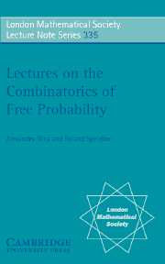
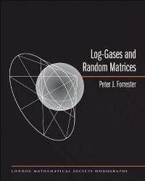
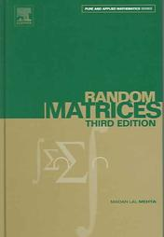
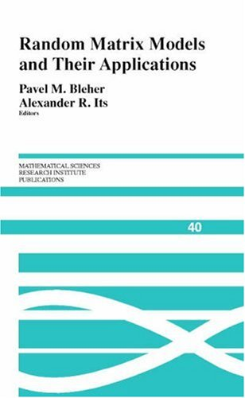
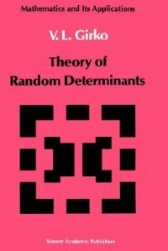
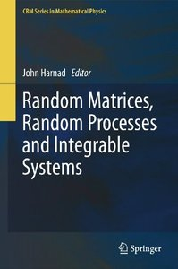
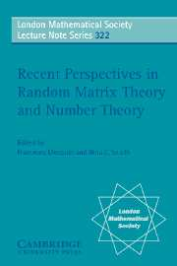

Slide 11
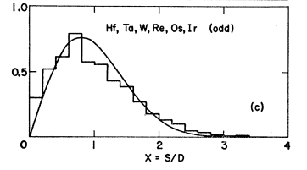
Early View of RMT
Heavy atoms too hard. Let’s throw
up our hands and pretend energy levels come from a random matrix
Our view
Randomness is a structure! A NICE STRUCTURE!!!!
Think sampling elections, central limit theorems,
self-organizing systems, randomized algorithms,…

Slide 12
The Marcenko-Pastur Law
The density of the singular values of a normalized rectangular random matrix with aspect ratio r and iid elements (in the infinite limit, etc.)

Slide 13
Covariance Matrix Estimation:
Source: http://www.math.nyu.edu/fellows_fin_math/gatheral/RandomMatrixCovariance2008.pdf

Slide 14
Hot off the presses
HED: New technique allows simulation of non-crystalline materials DEK: Multidisciplinary team develops mathematical approach that could help in simulating materials for solar cells and LEDs. BYLINE: David L. Chandler, MIT News Office

Slide 15
Part 2: Julia
Stereotypes:
MATLAB® is for engineers
R is for statisticians
Python is for young people
Mathematica® is for physicists
Maple® is for mathematicians
French was designed for French people
Spanish was designed for Spanish people

Slide 16
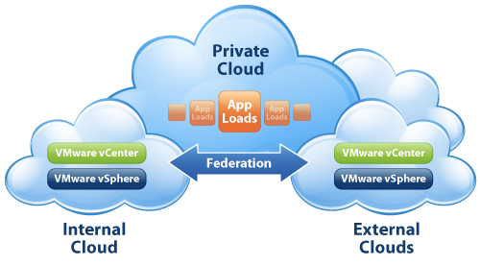
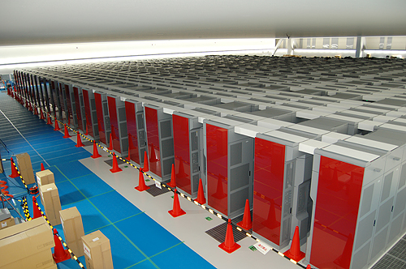
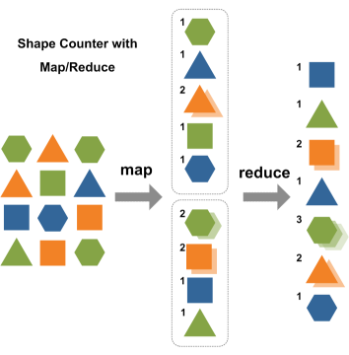
“Disconnected” Technical Computing World
Desktop Productivity
Cloud Potential
Supercomputer Power

Slide 17
“Disconnected” Technical Computing World
Desktop Productivity
Cloud Potential
Supercomputer Power
☺Easy on Humans
☺Non-Expert Users
☺Interface to vast libraries
☹Desktop Performance
☹Deep Chasm to cross
☺The Raw Power
Hard on Humans
Software
☺The Village
☺The Market
☺The Availability

Slide 18
Julia
Announced this year:
Jeff Bezanson, Stefan Karpinski, Viral Shah, AE
“Convenience is winning”: Jeff Bezanson
Solves the “Two Language” Technical Computing Problem:
Scripting in one language
Other Languages needed for
Blockbuster subroutines
Performance/Deployment
Vibrant Development Community
Flexible Parallelism
Poised for Big Data
Science and national agencies increasingly demand Open Source ← Trend will likely continue

Slide 20
Two New Technologies
Random Matrix Theory
Julia

