Slide 1
David in Asia

Slide 2
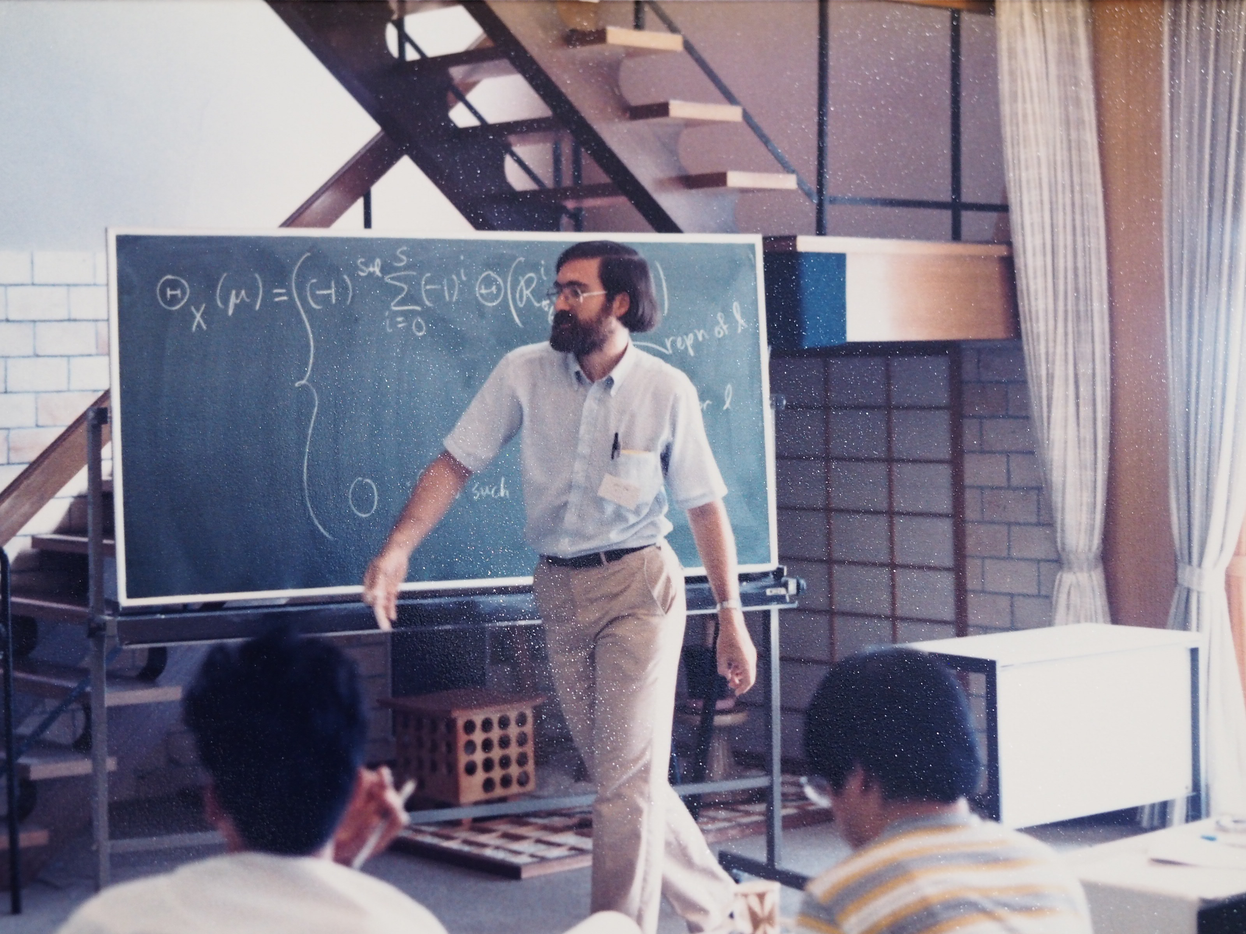
Taniguchi Symposium, Katata, Japan
1986

Slide 3
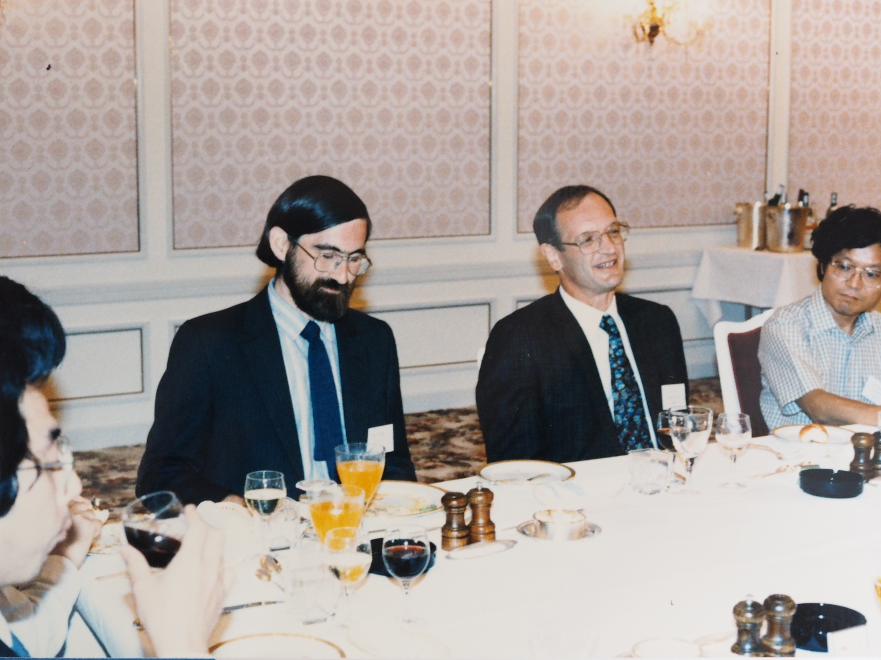
Taniguchi Symposium, Katata, Japan
1986

Slide 4
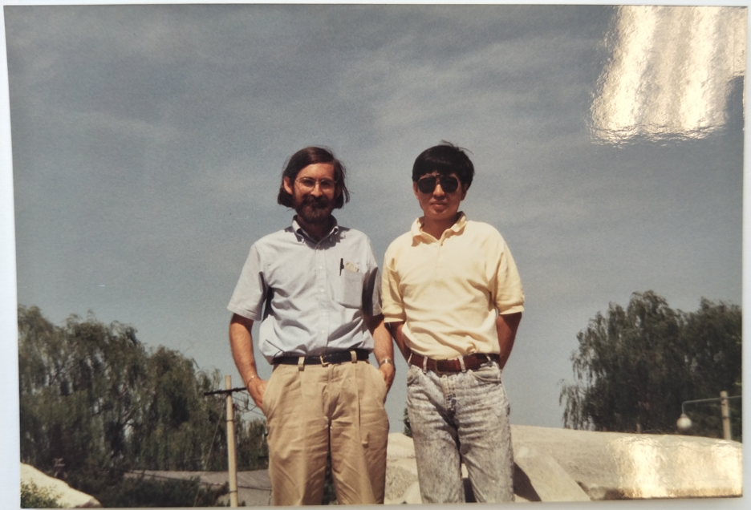
Old Summer Palace, Beijing, China
1994

Slide 5
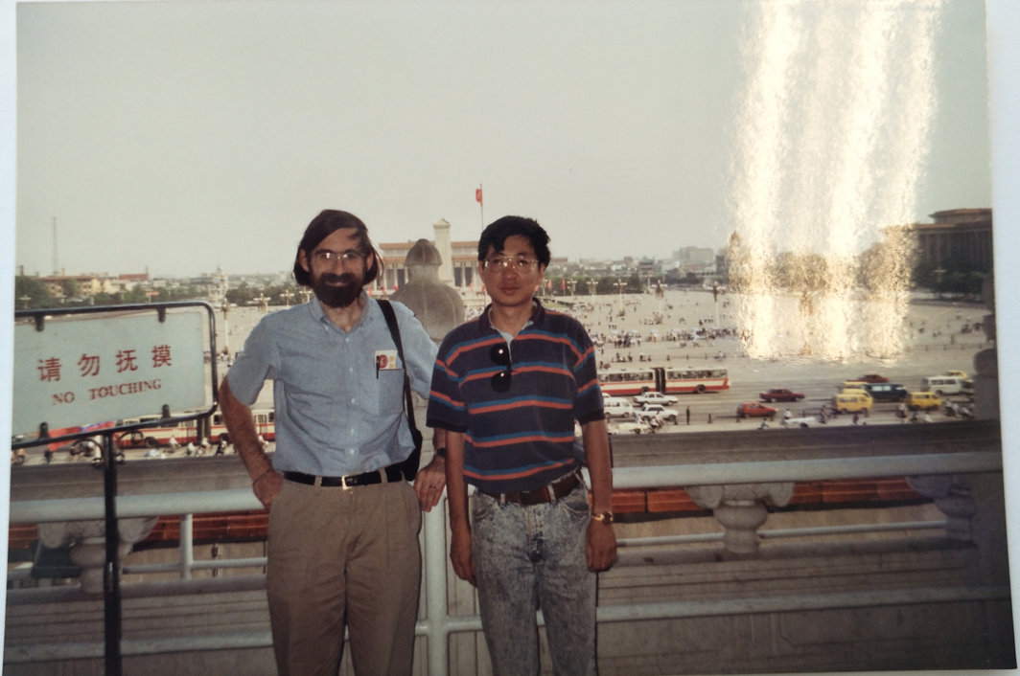
Tiananmen Gate Tower, Beijing, China
1994

Slide 6
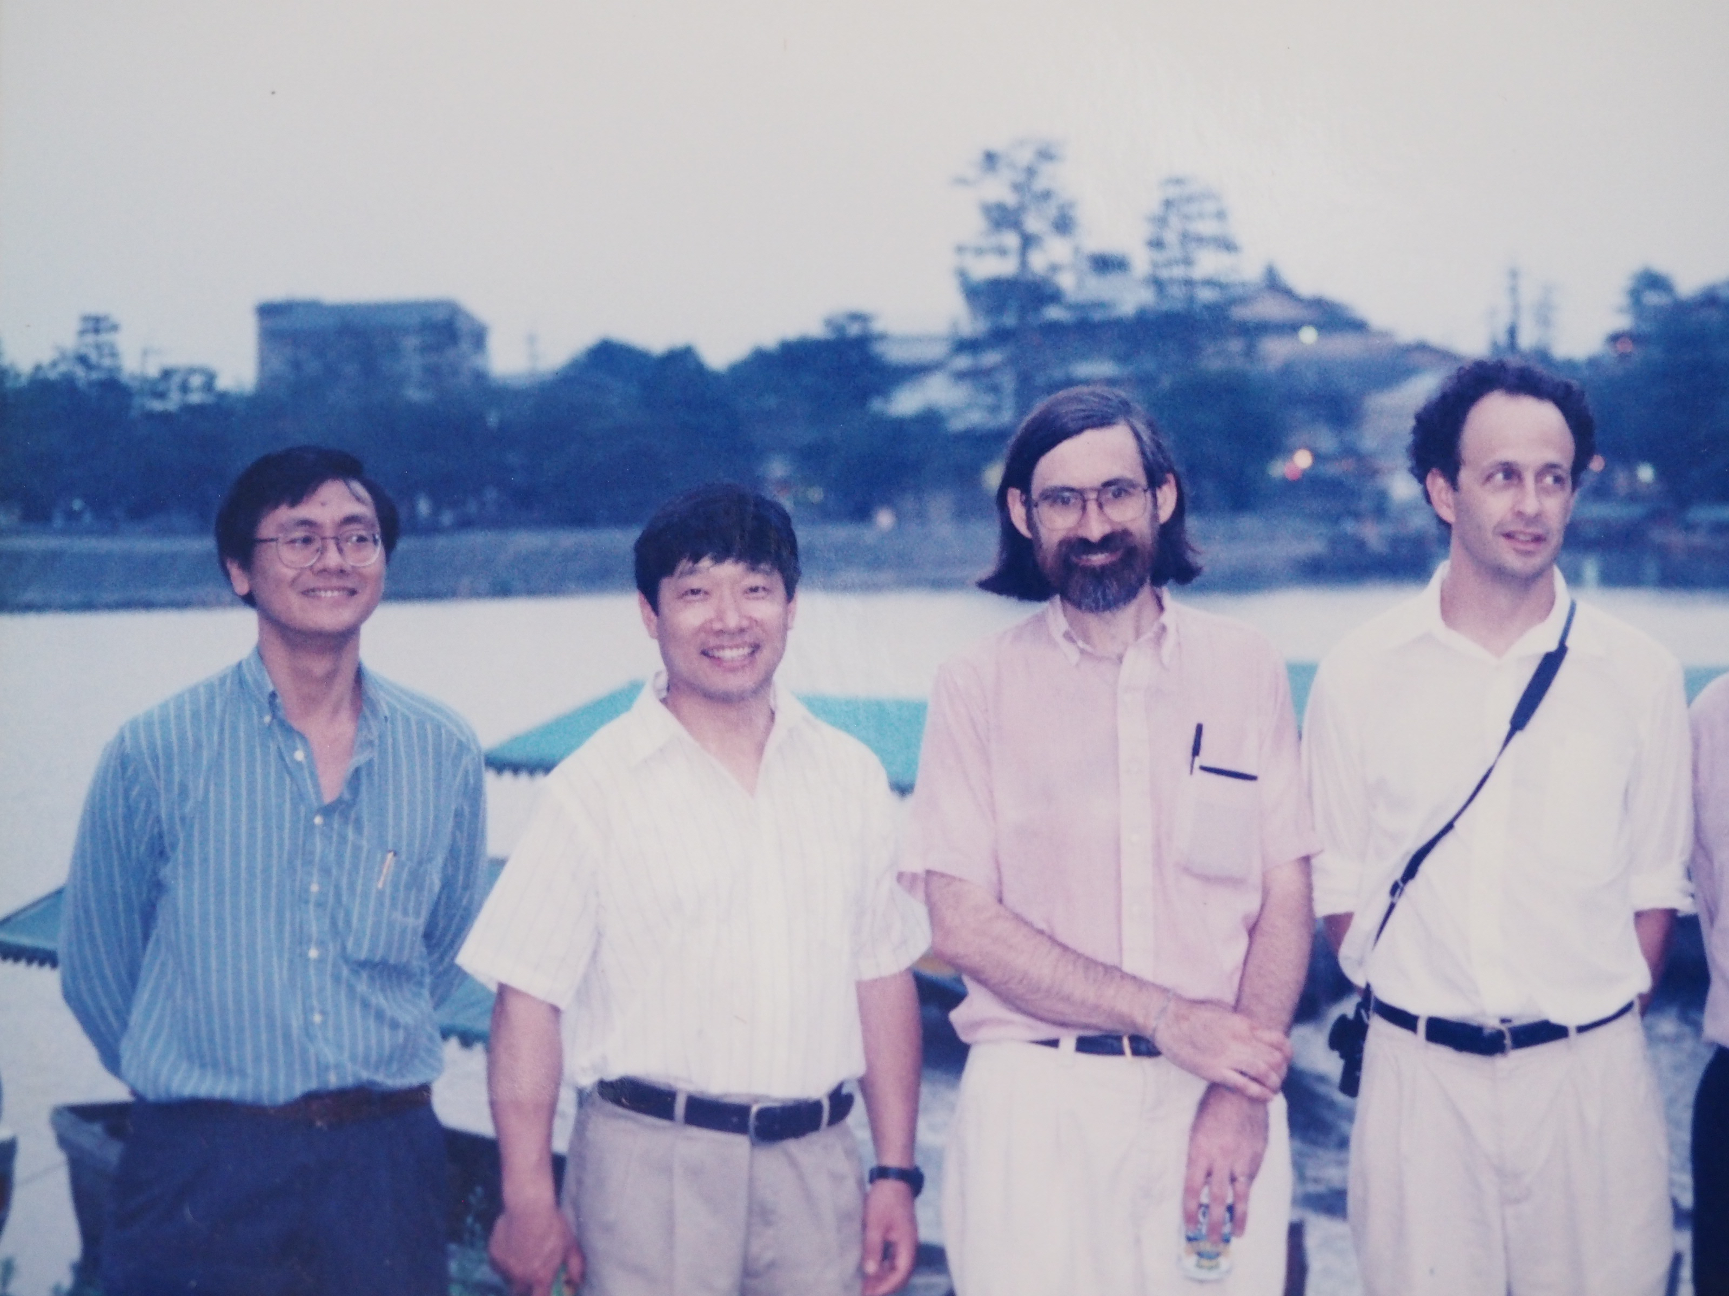
Hayashibara Symposium, Japan, 1997

Slide 7
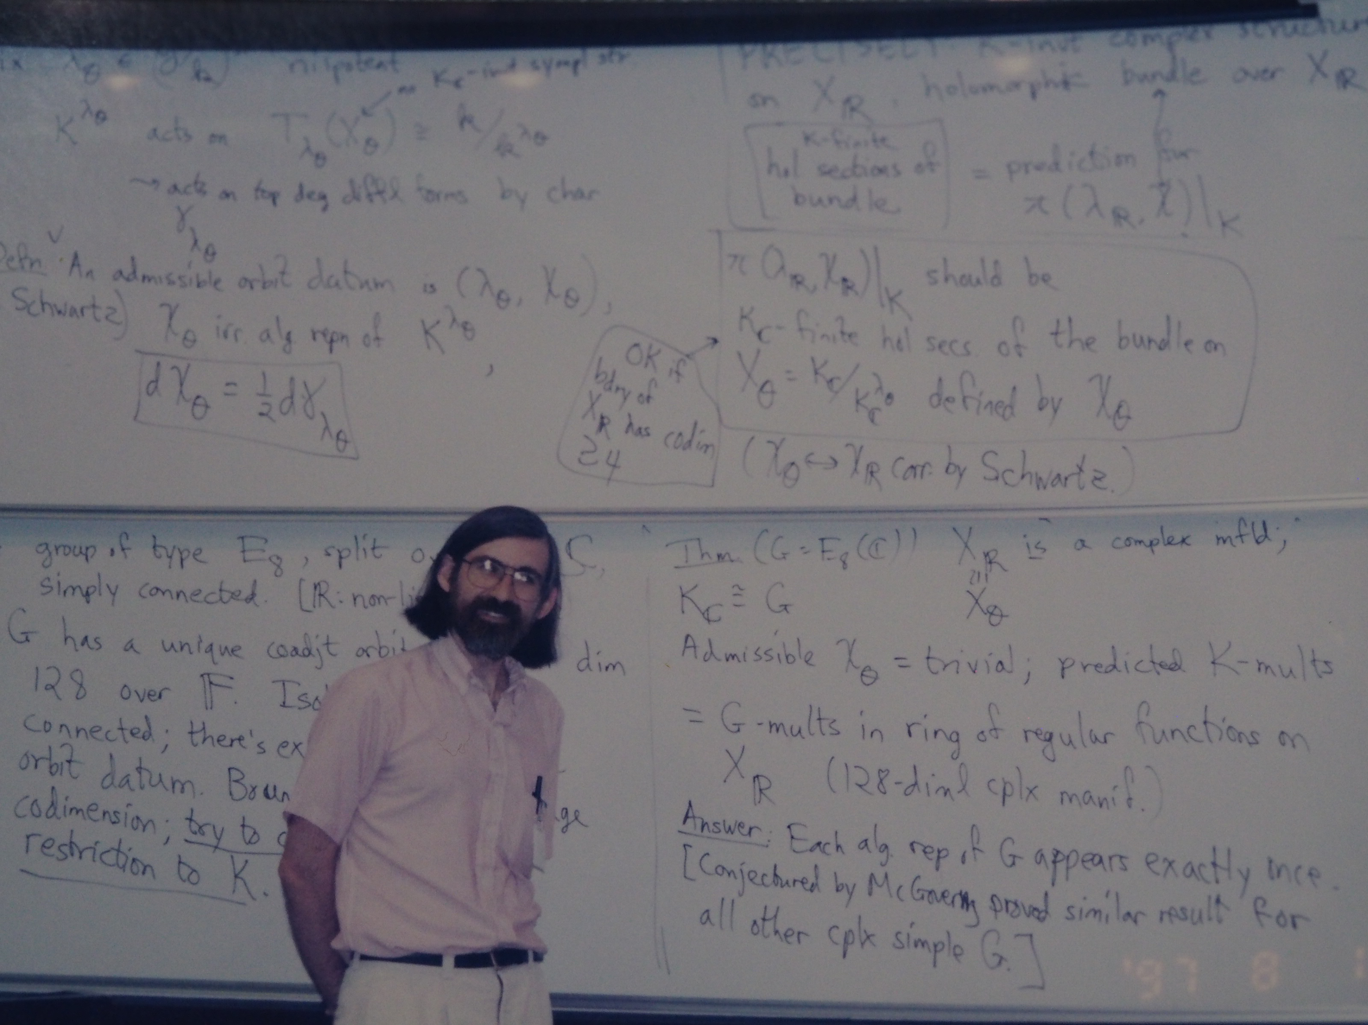
Hayashibara Symposium, Japan, 1997

Slide 8
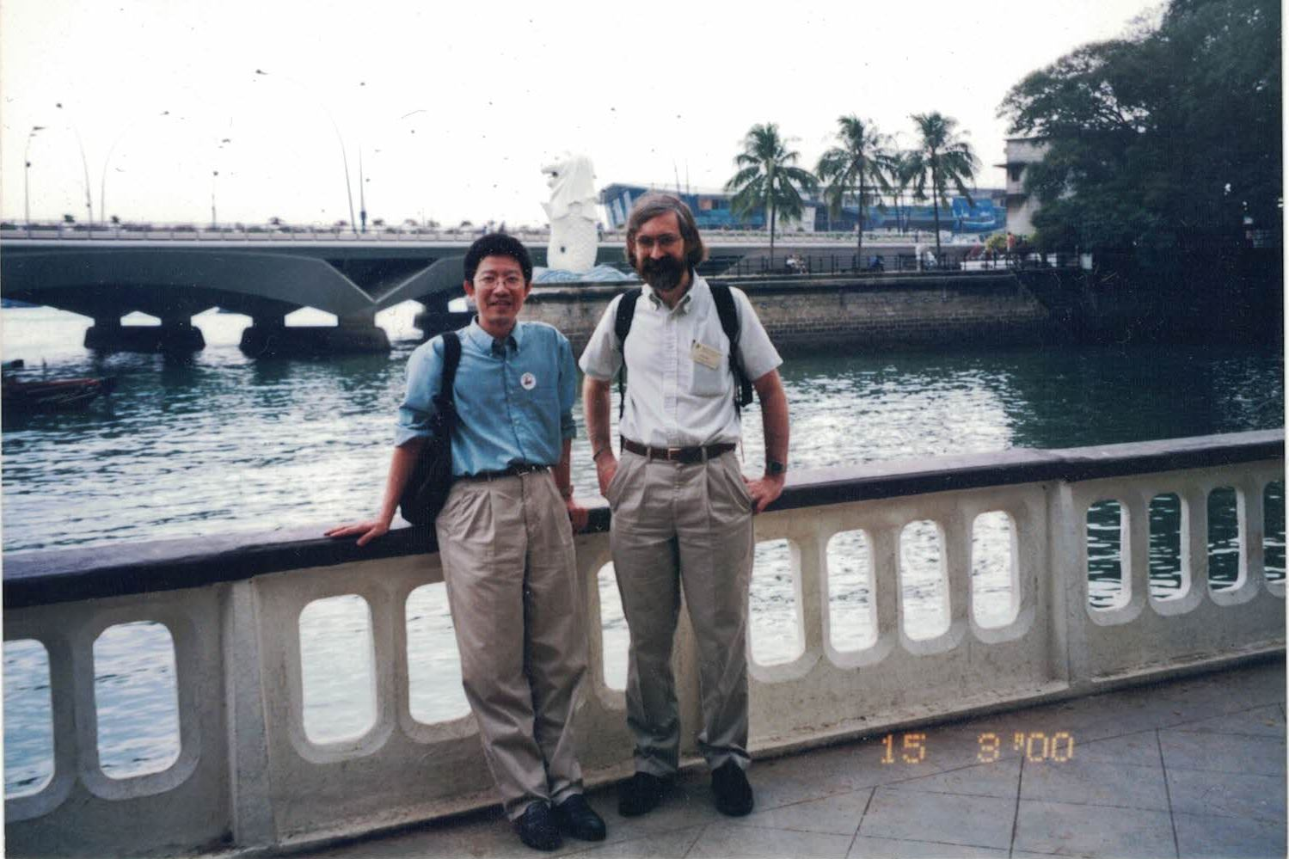
Singapore River, Singapore, 2000

Slide 9
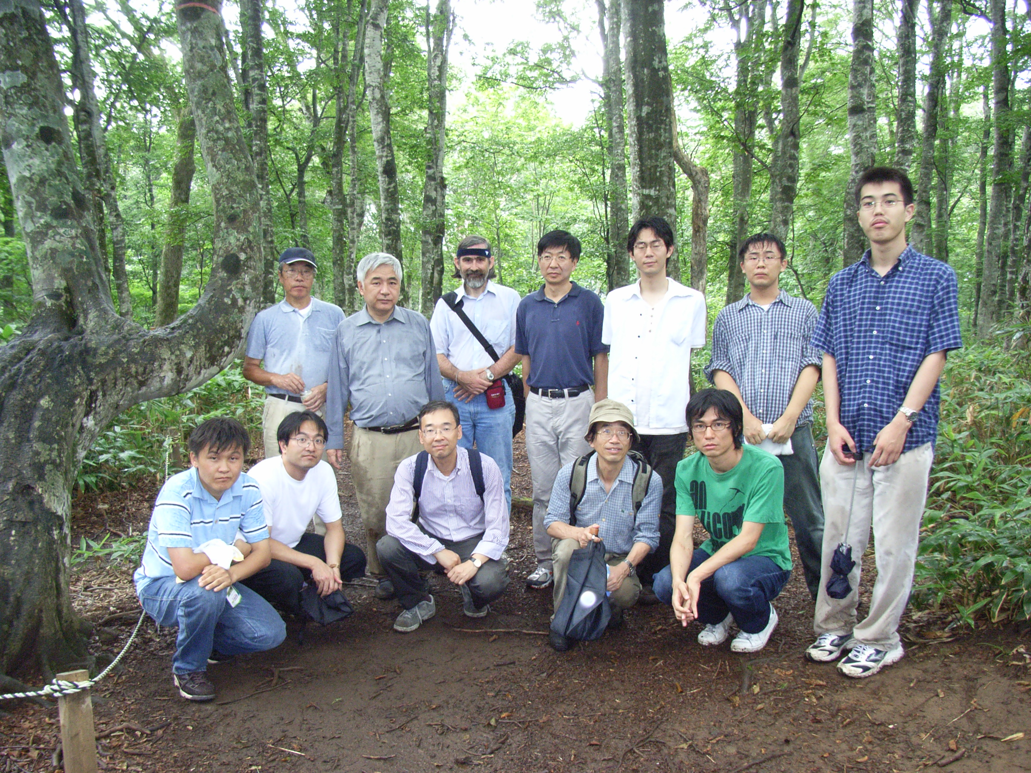
Tambara Workshop, Japan, 2007

Slide 10
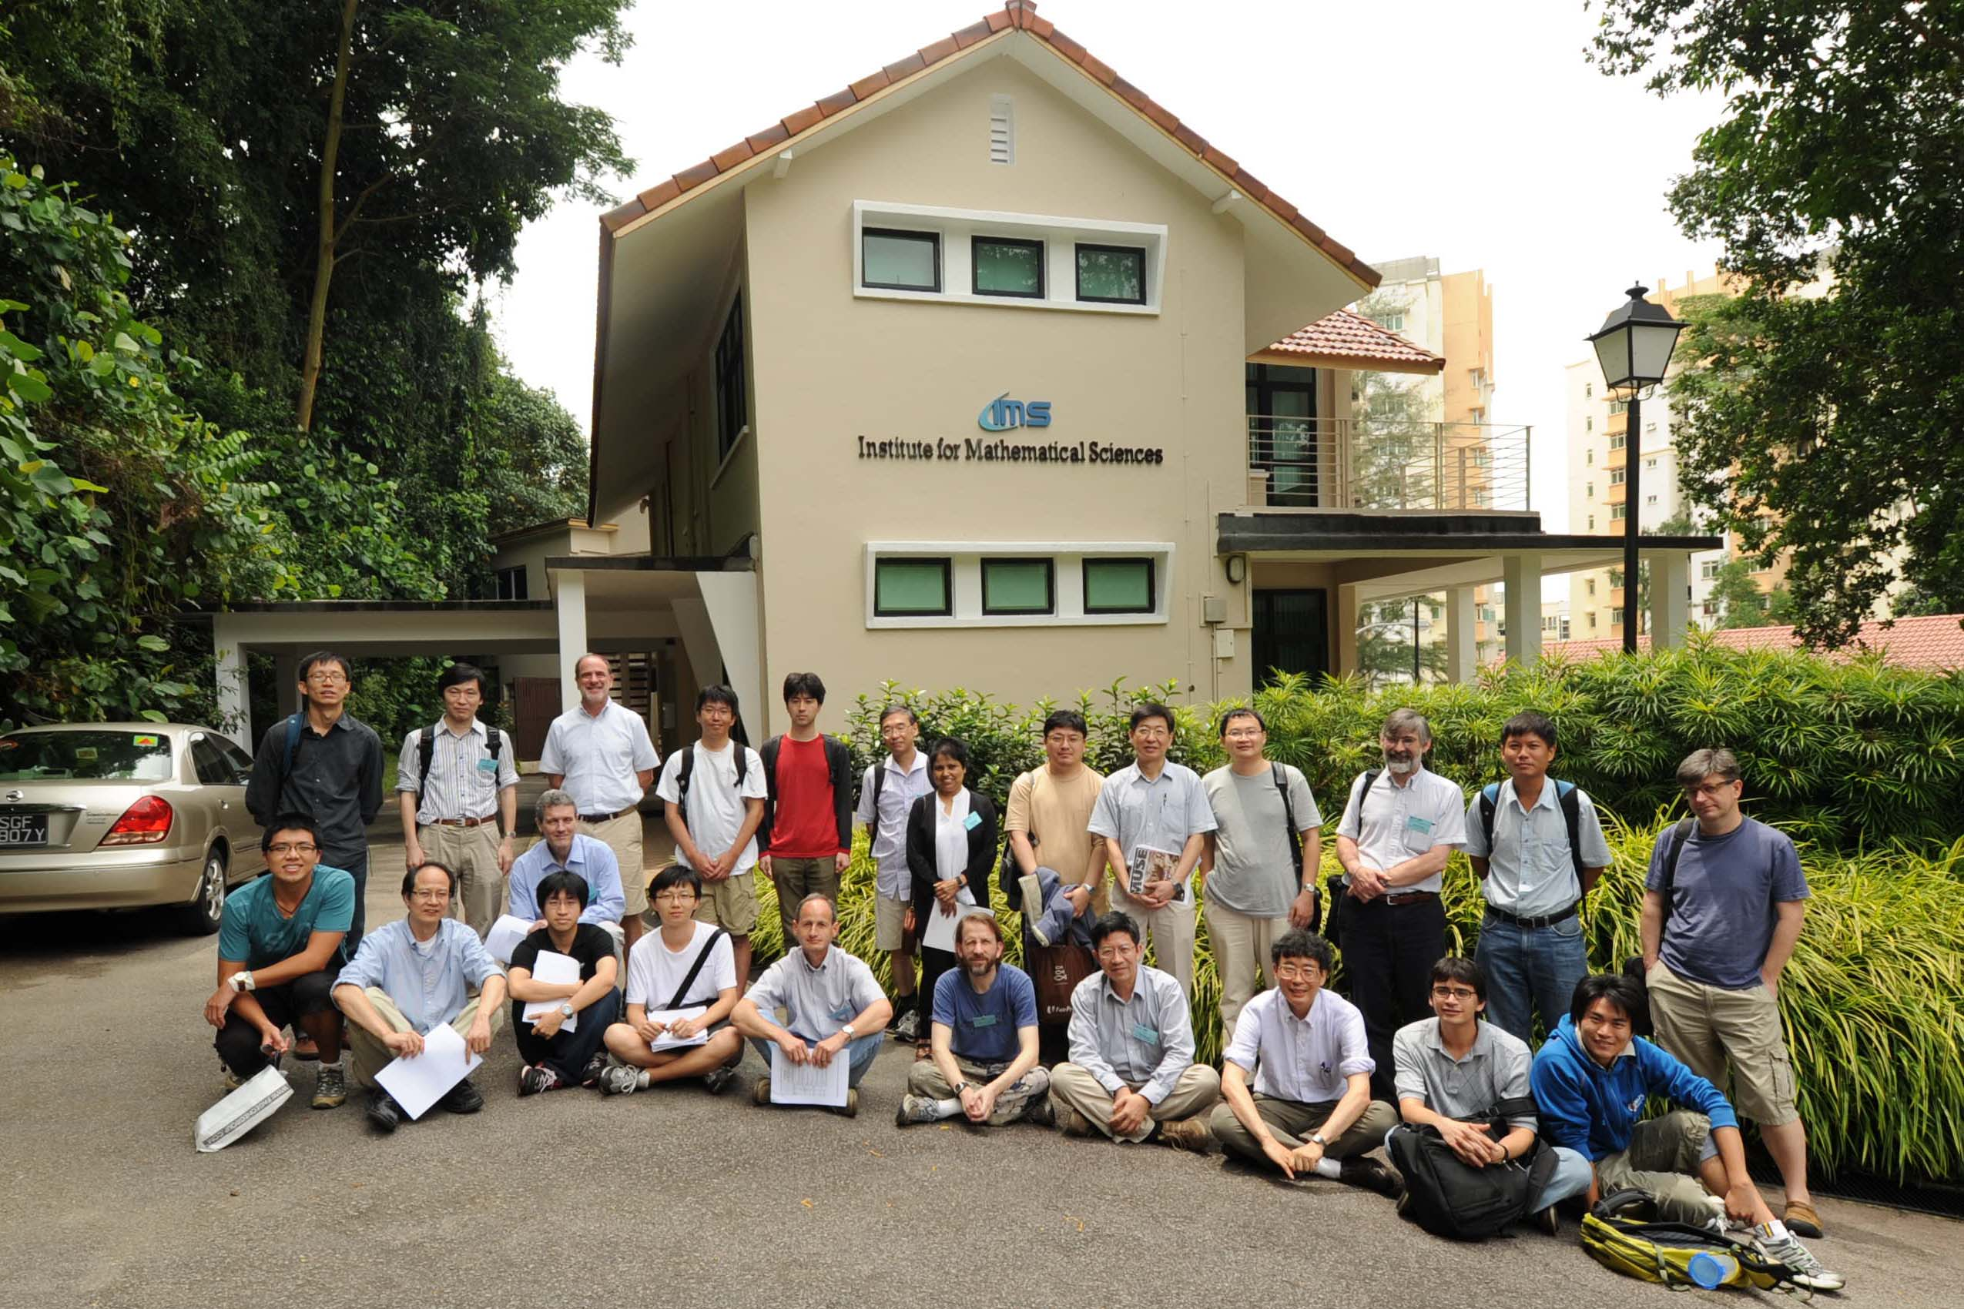
Branching Laws, Singapore, 2012

Slide 11
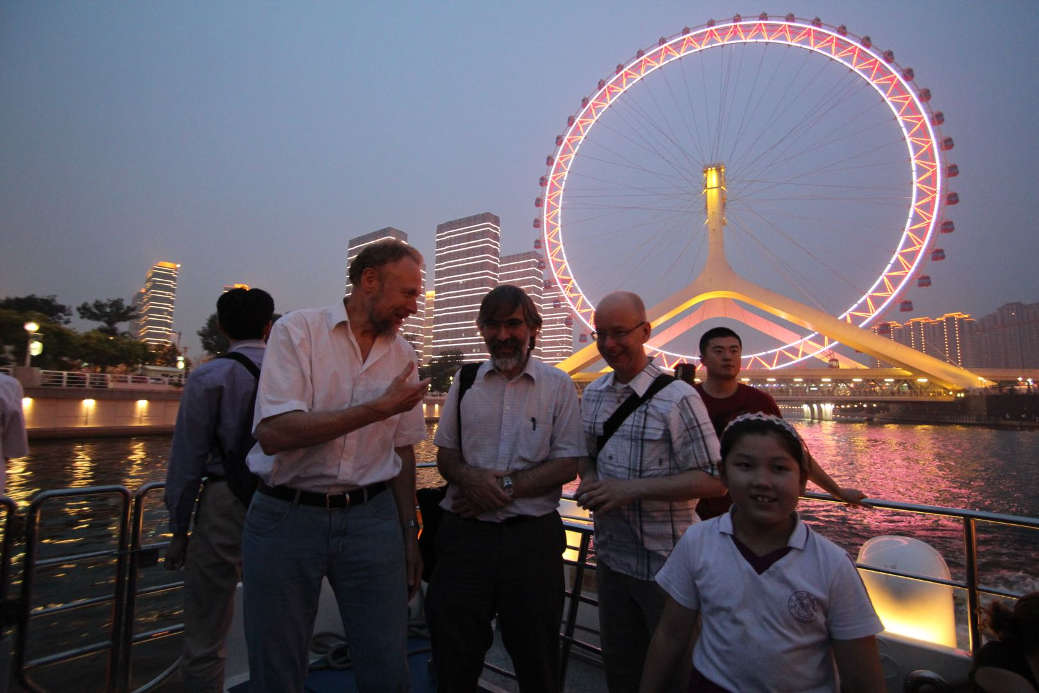
Tianjin, China, 2012

Slide 12
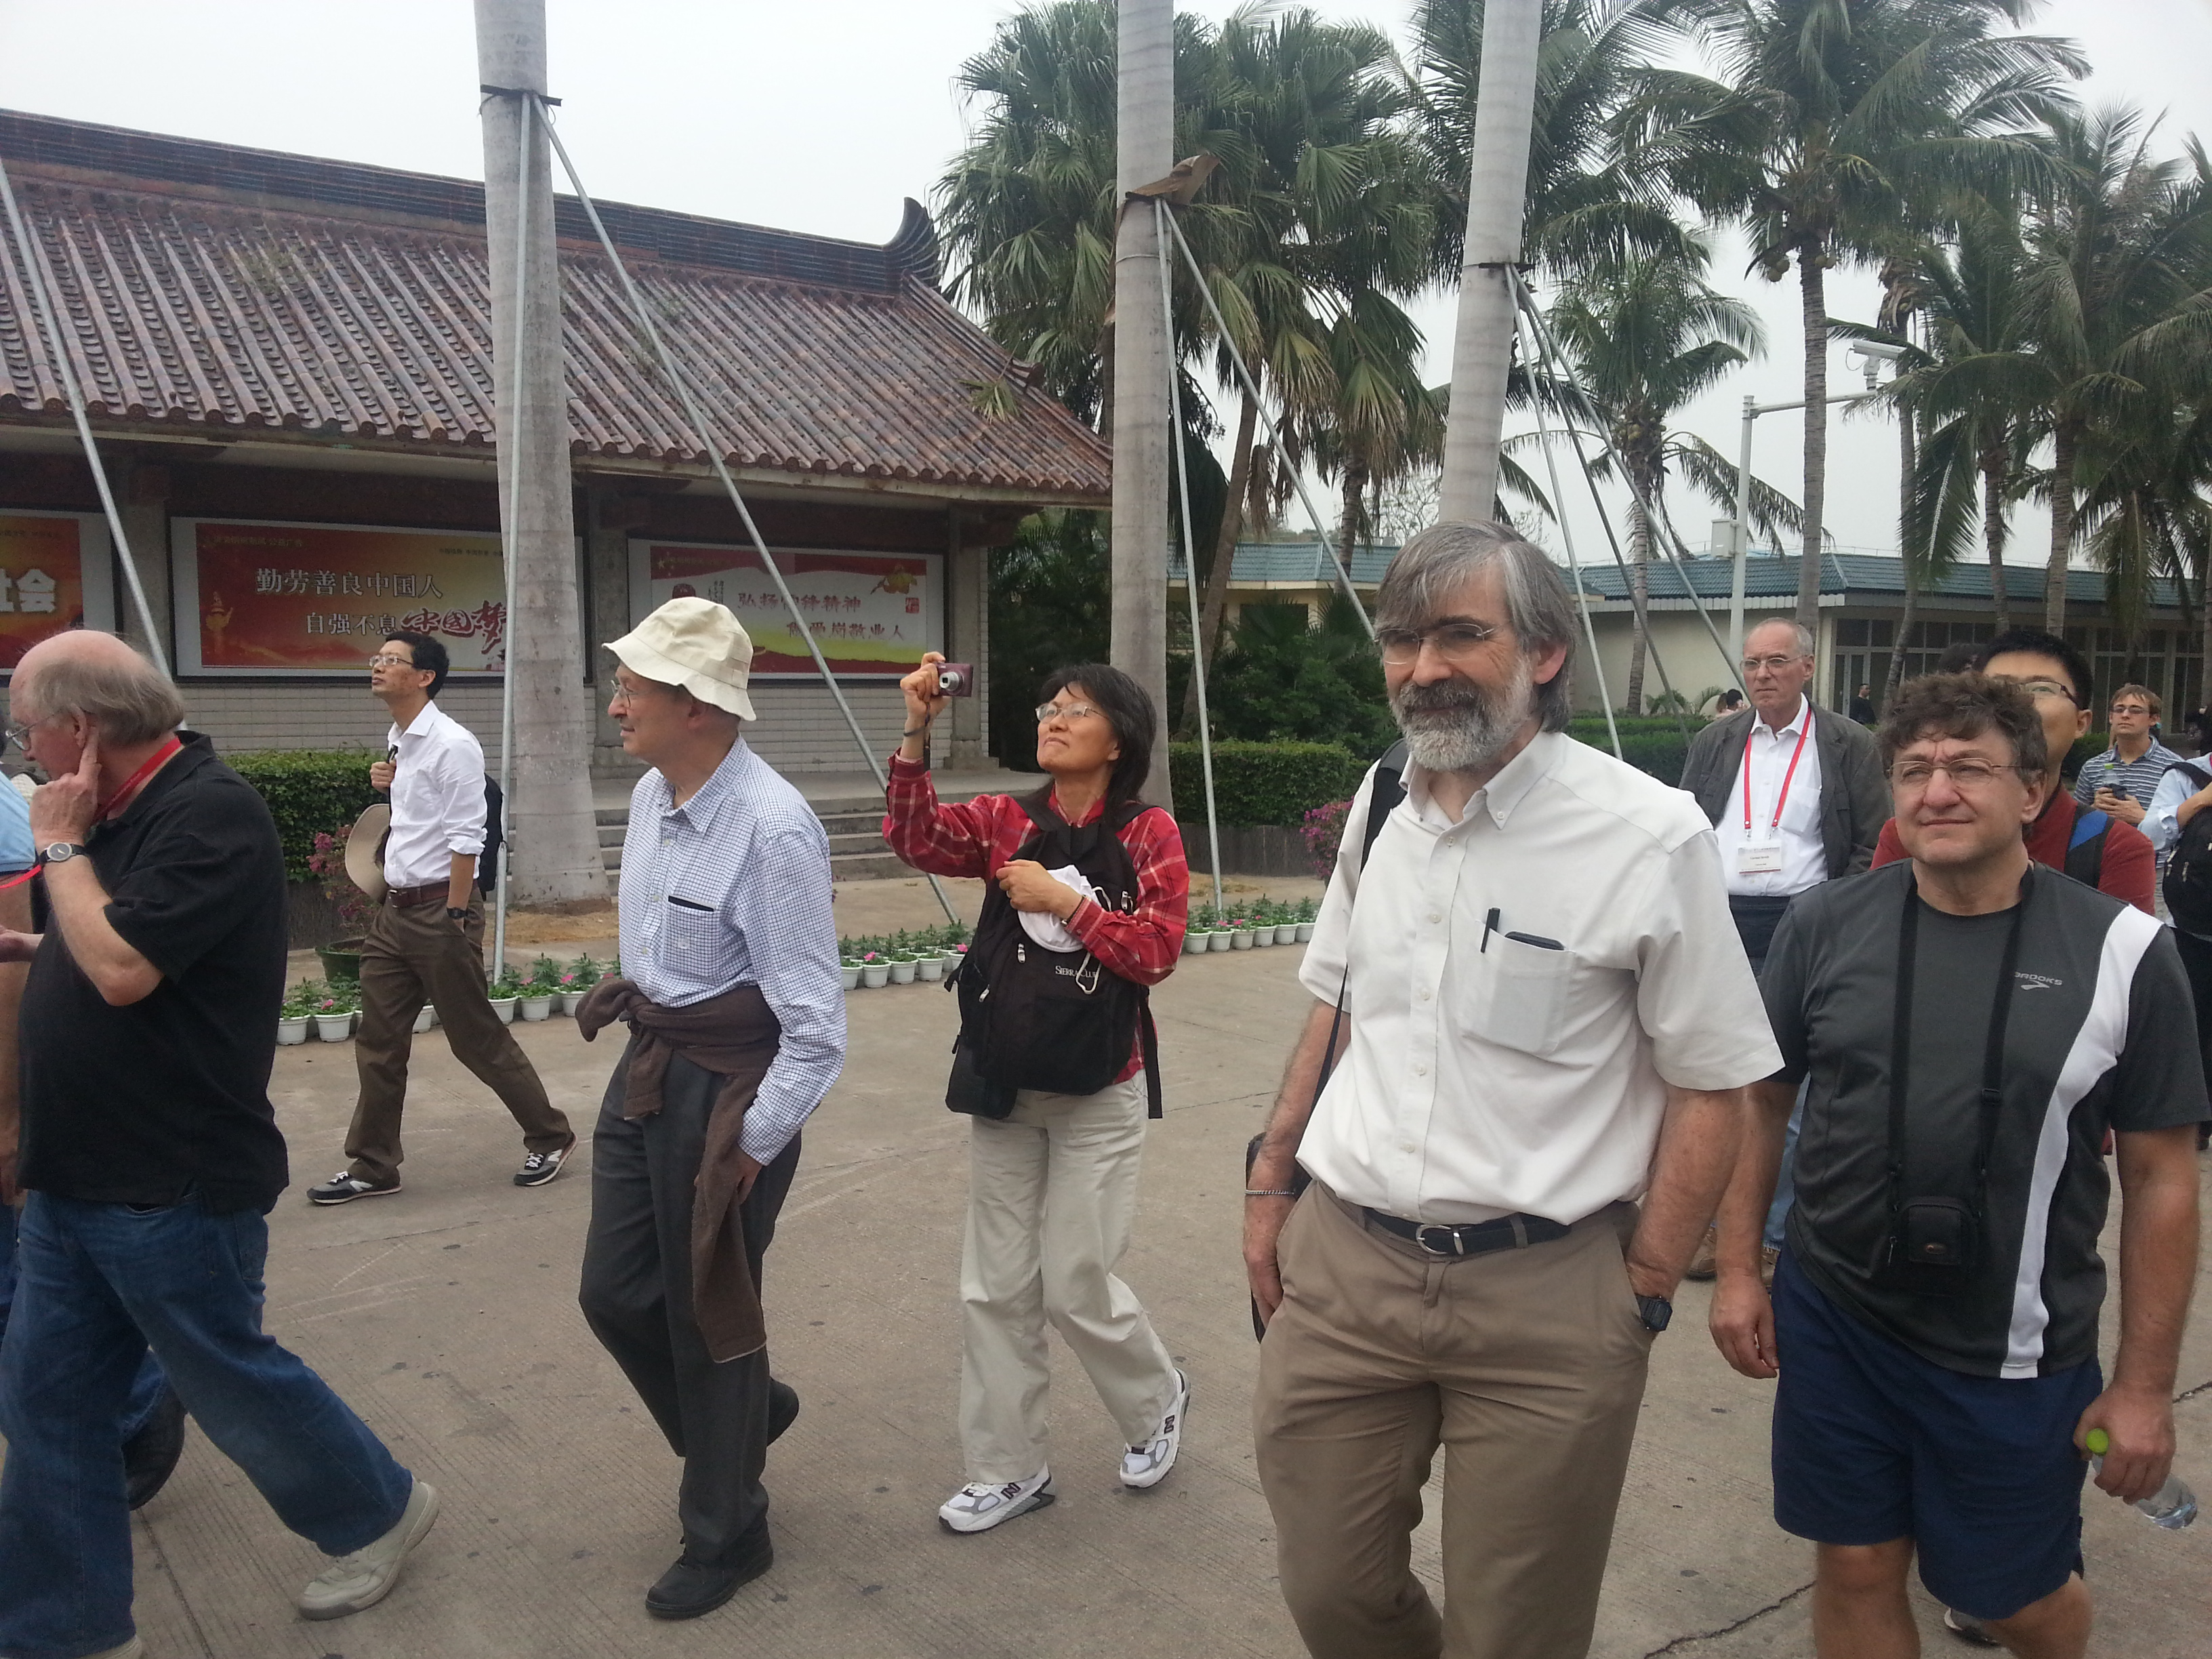
Sanya, China, 2014

Slide 13
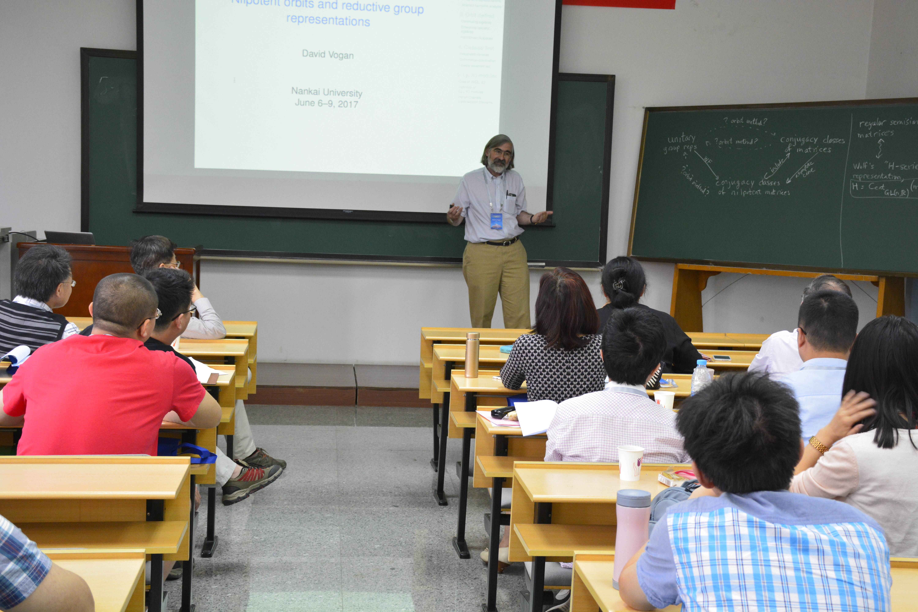
Tianjin, China, 2017

Slide 14
Tianjin, China, 2017

Slide 15
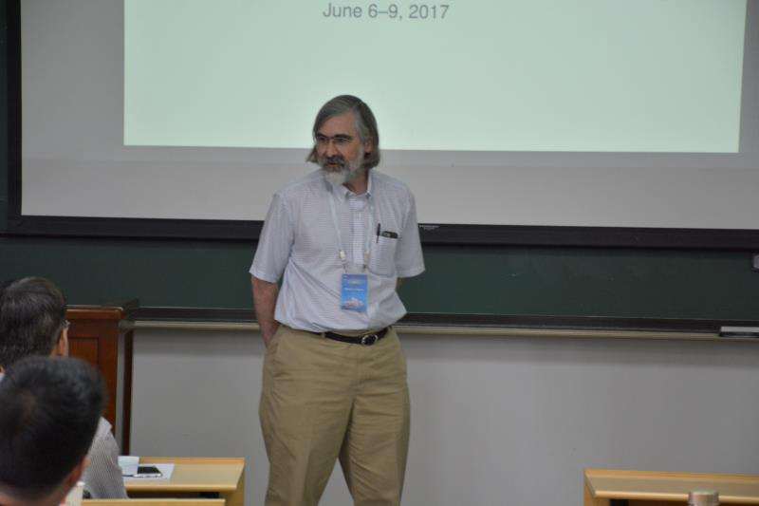
Tianjin, China, 2017

Slide 16
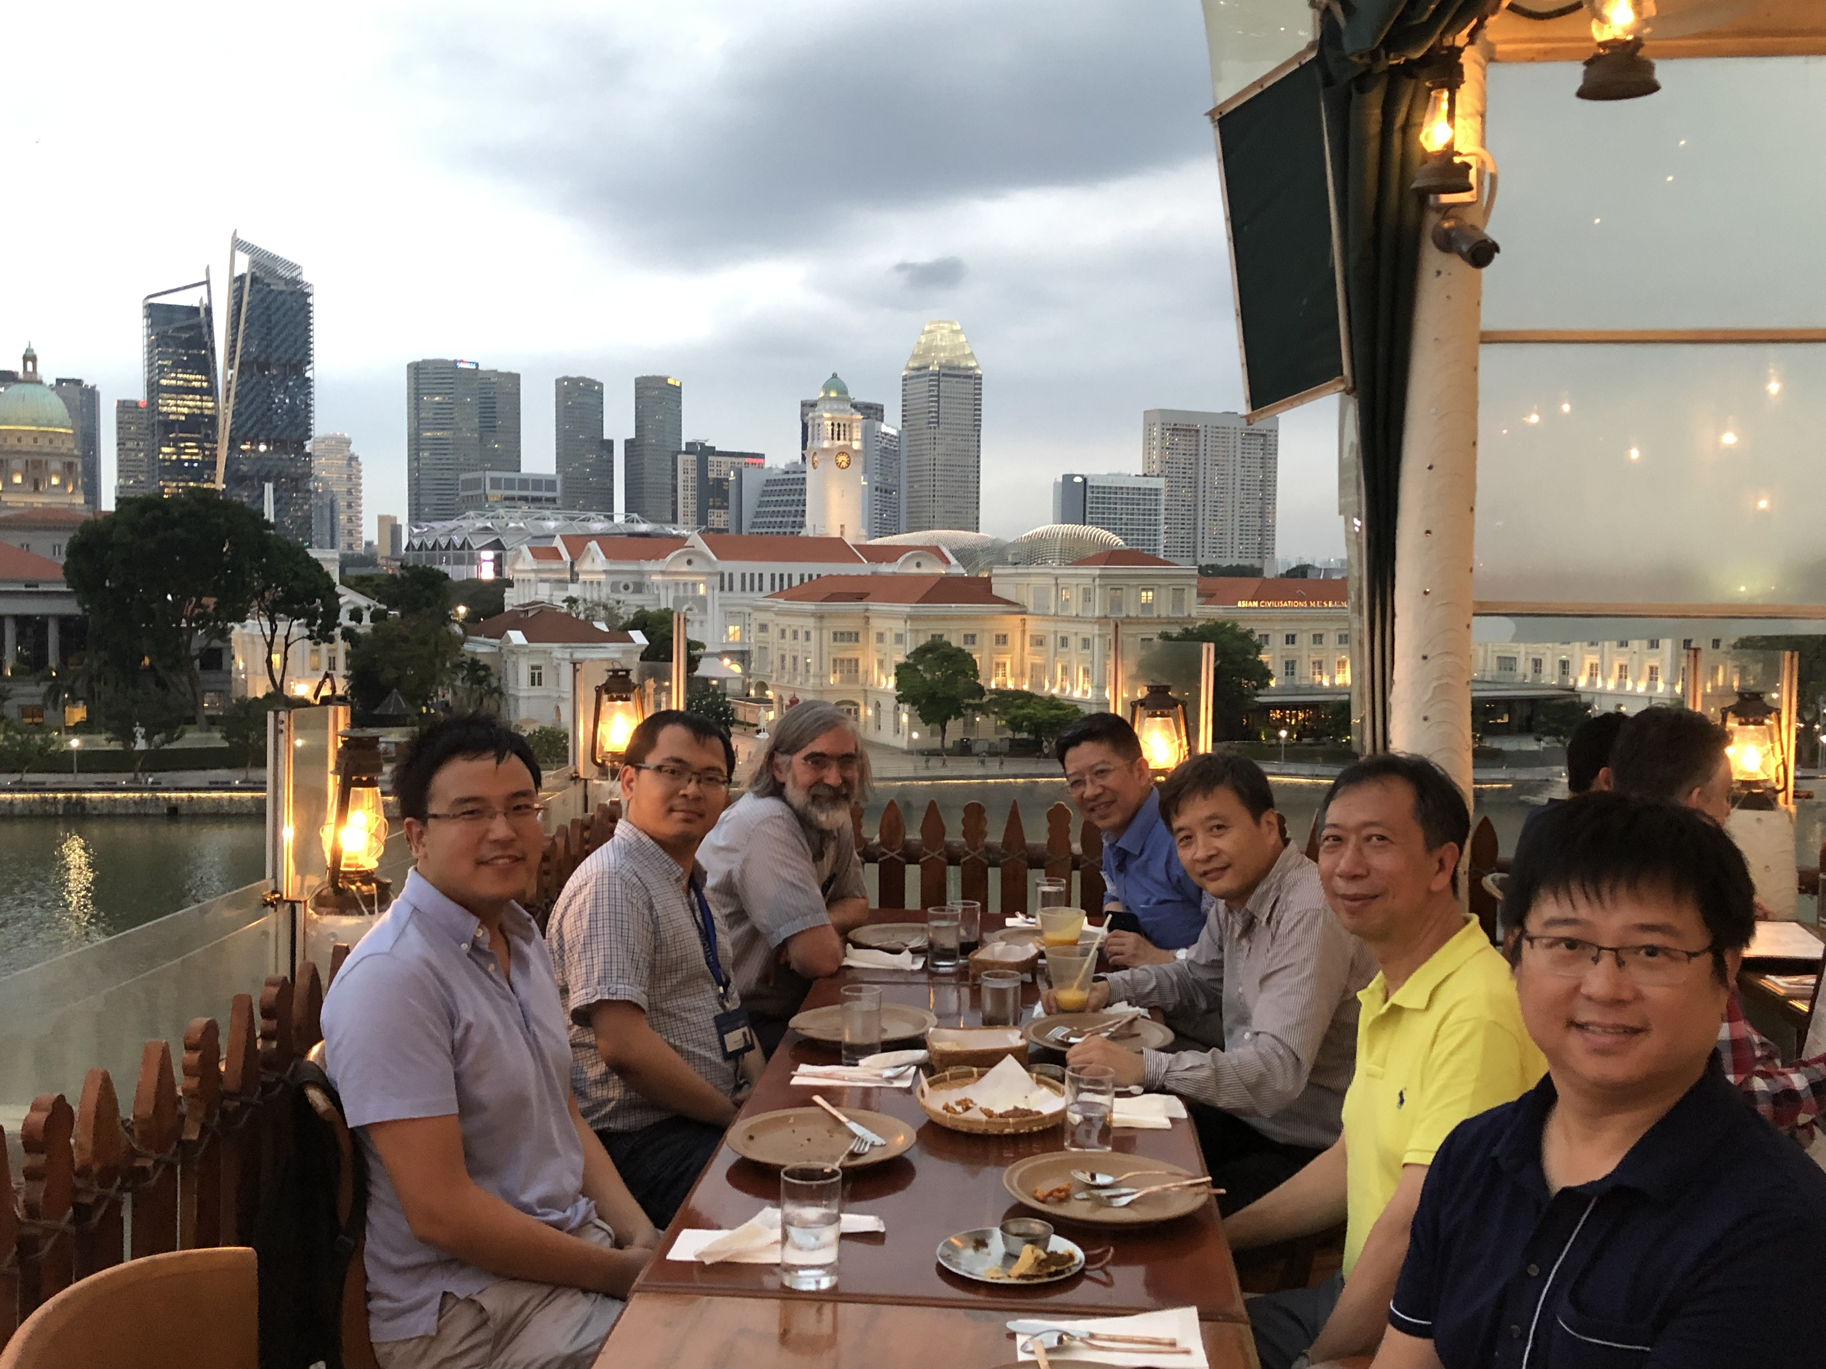
Singapore, 2019

Slide 17
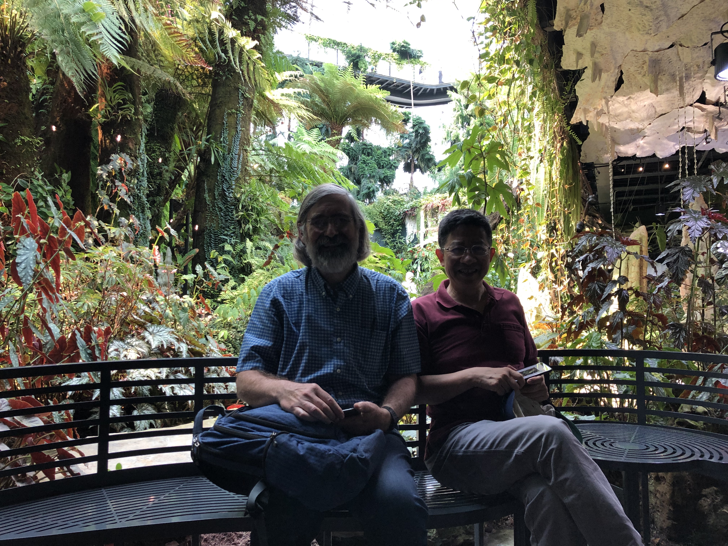
Singapore, 2019

Slide 18
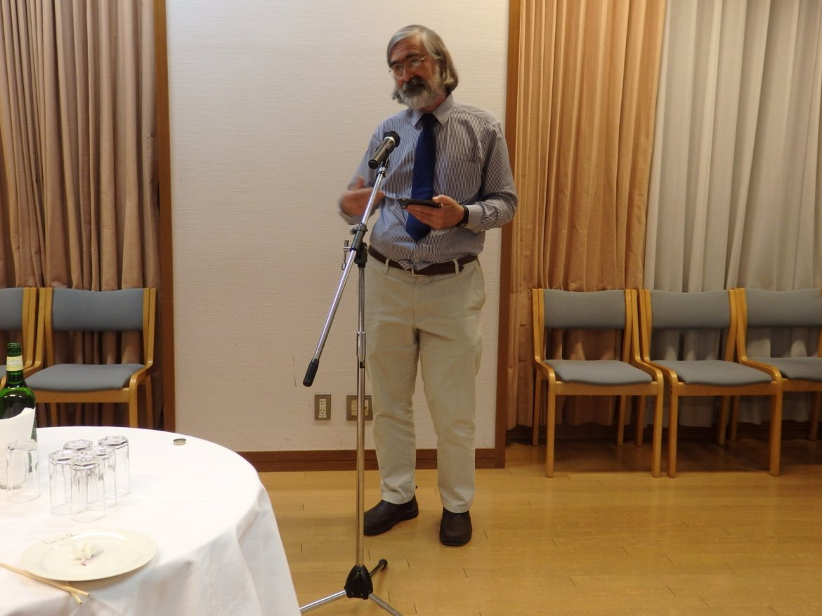
Tokyo, Japan, 2019

Slide 19
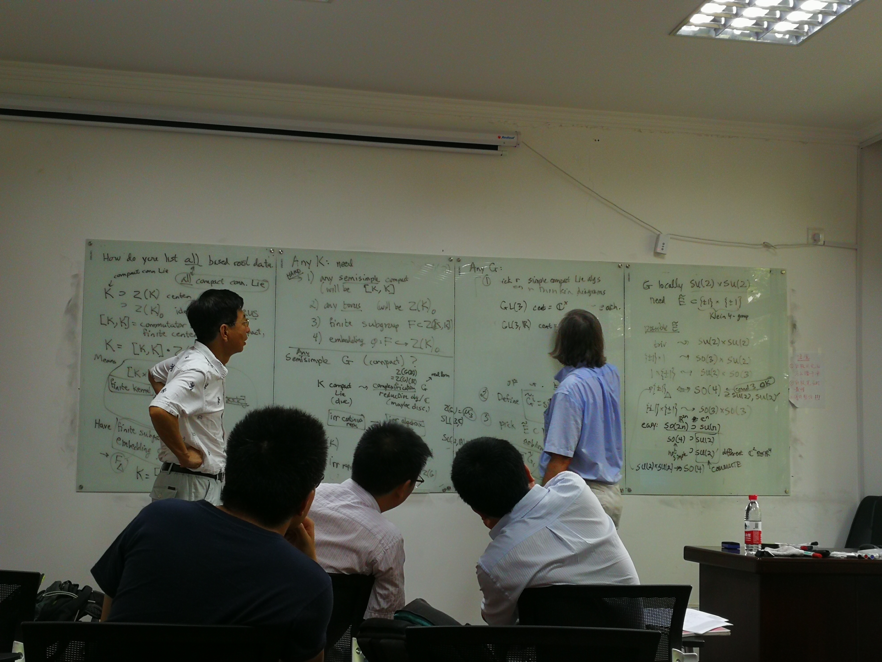
Shanghai, China, 2019

Slide 20
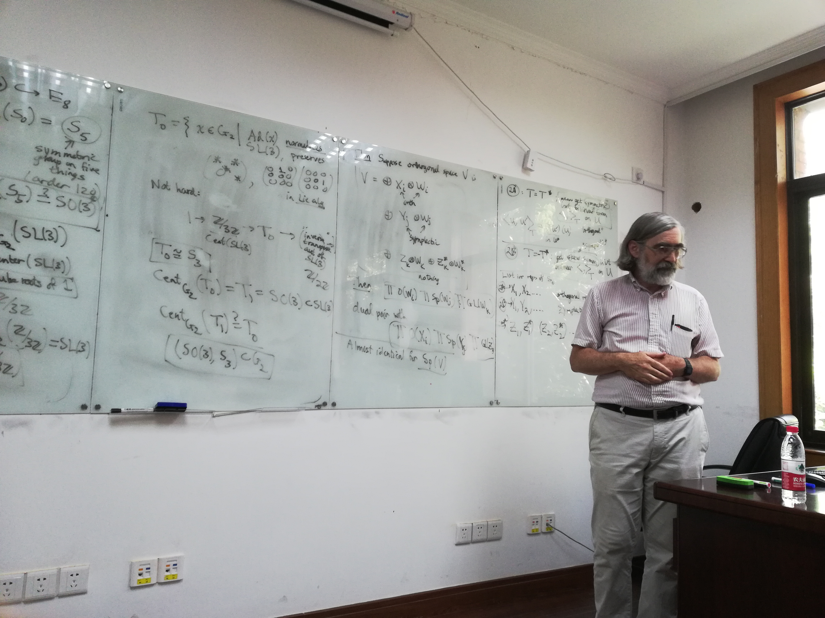
Shanghai, China, 2019

Slide 21
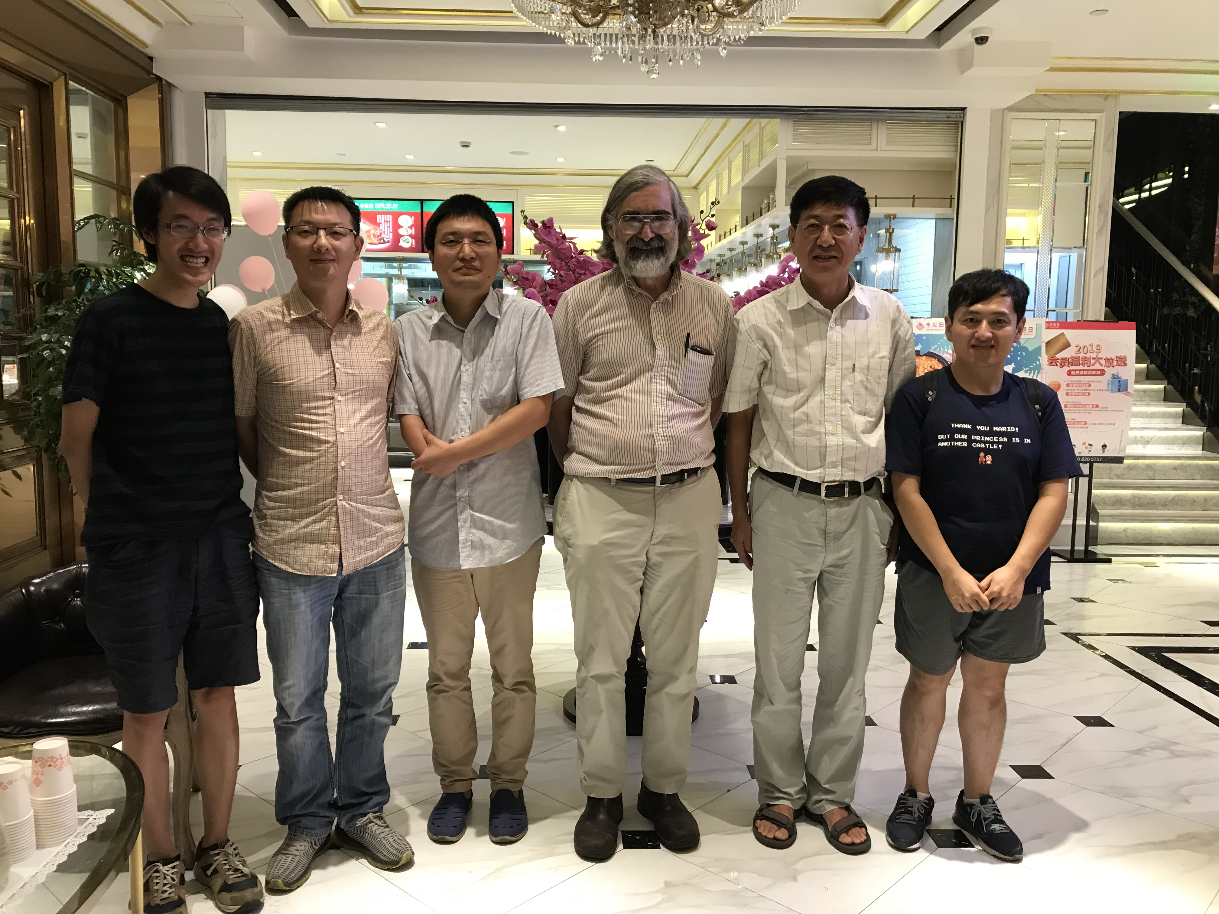
Shanghai, China, 2019

Slide 22
Contributors of photos
Chaoping Dong
Jing-Song Huang
Toshio Oshima
Liang Yang
Xiaomei Yang
Jun Yu
Lei Zhang
Mingjing Zhang
Chengbo Zhu

Slide 23
Thank you, David

