Slide 1
What are the Eigenvalues of a Sum of (Non-Commuting) Random Symmetric Matrices? : A "Quantum Information" inspired Answer.
Alan Edelman
Ramis Movassagh
Dec 10, 2010
MSRI, Berkeley

Slide 2
Complicated Roadmap

Slide 3
Complicated Roadmap

Slide 4
Simple Question
The eigenvalues of
where the diagonals are random, and randomly ordered. Too easy?

Slide 5
Another Question
The eigenvalues of
where Q is orthogonal with Haar measure. (Infinite limit = Free probability)

Slide 6
Quantum Information Question
The eigenvalues of
where Q is somewhat complicated.
(This is the general sum of two symmetric matrices)

Slide 7
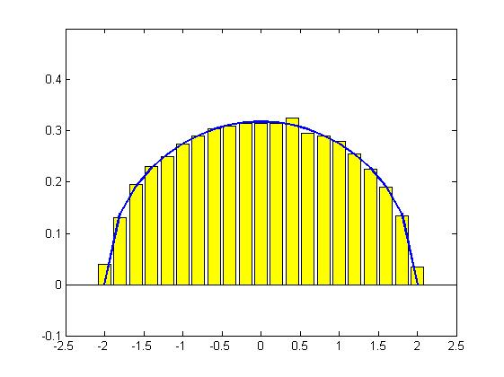
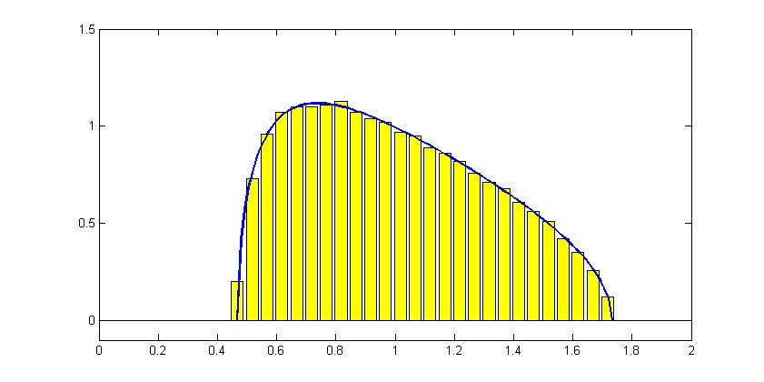
What kind of an answer?
A Histogram or Eigenvalue Measure
Example
Example

Slide 8
What kind of an answer?
A Histogram or Eigenvalue Measure
Example
Example
?

Slide 9
Now that eigenvalues look like random variables
Q=I
Classical sum of random variables
Pick a random eigenvalue from A, and a random eigenvalue from B uniformly and add
= Classical convolution of probability densities
=

Slide 10
Now that eigenvalue histograms look like random variables
Q=Haar Measure
Isotropic sum of random variables:
Pick a random eigenvalue from A+QBQ’
= Isotropic convolution of probability densities
depends on joint densities and
(covariance of eigenvalues matters!)
Real β=1, complex β=2, (quaternion, ghost…) matters

Slide 11
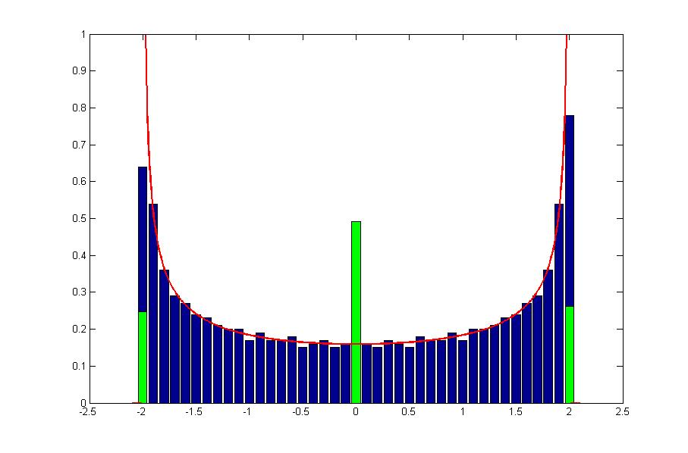
Free probability
← Free and classical sum of coin tosses (±1)
Free sum of random variables:
Pick a random eigenvalue from A+QBQ’
Take infinite limit as matrix size gets infinite
No longer depends on covariance or joint density
No longer depends on β
Infinite limit of “iso” when taken properly

Slide 12
More slides
I Kron A + B kron I (A and B anything)
Eigenvalues easy here right? Just the sum
For us now, that’s classical sum
That’s just if both are nxn
But in quantum information the matrices don’t line up
Something about d and d^2 and d^2 and d

Slide 13
More about how the line up leads to entanglement and difficulties even before seeing the H

Slide 14
OK Now the H (maybe not yet in Q format)
Notice what’s easy and what’s hard
The even terms are still easy
The odd terms are still easy
The sum is anything but

Slide 15
Complicated Roadmap

Slide 16
We hoped free probability would be good enough
That was our first guess
It wasn’t bad (sometimes even very good)
It wasn’t good enough
Here’s a picture (maybe p around the middle)
(probably N=3 d=2) p=,478
Animation could be cool here

Slide 17
Hint at the hybrid
But main point now is to say that the mathematics turned out nicer than we expected
Answers “universal” (I hate that word), independent of the densities of eigenvalues
Maple story – we thought we didn’t clear the memory

Slide 18
Now to drill down on the slider
First was about matching 4th moments

Slide 19
Complicated Roadmap

Slide 20
But here’s what matching four moments tends to look like
See not good enough
We’re getting more somehow

Slide 21
And now some math
Here are the q’s for quantum

Slide 22
Here are the 4th moments
First three moments are the same
How cool is that
Who would have guessed
And also probably the departure theorem

Slide 23
We have a slider theorem

Slide 24
Slide n-1
Speculation about the sum of any symmetric matrices

